Slide 1
TALES, TRAILS, AND TWO-FIFTY
OCTOBER 6, 2023

Slide 2
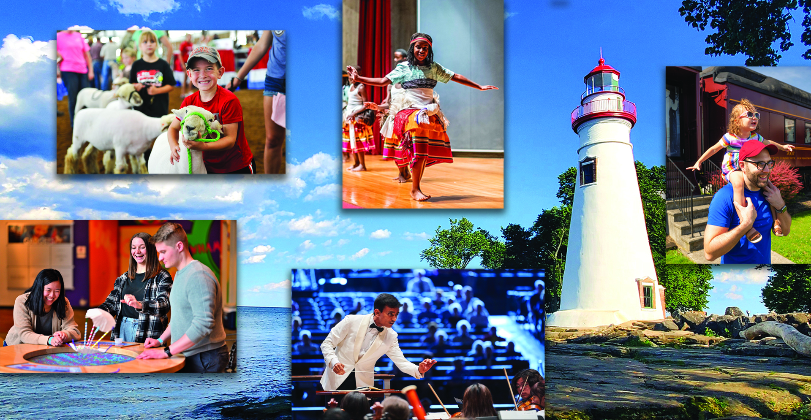
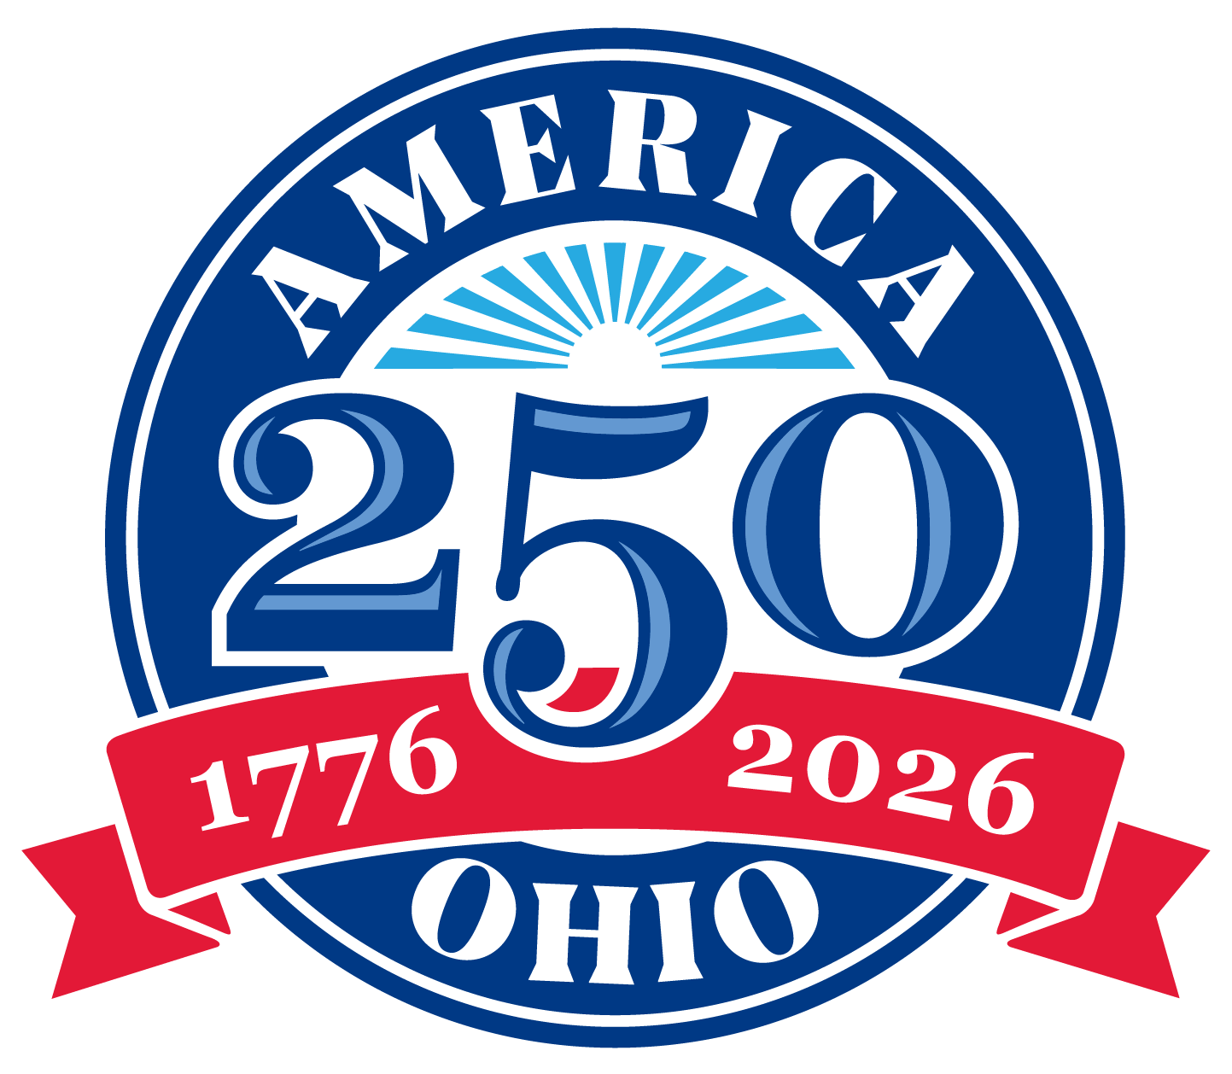
America 250-Ohio
Celebrating Ohio’s Contributions
to the U.S. for 250+ years.

Slide 3
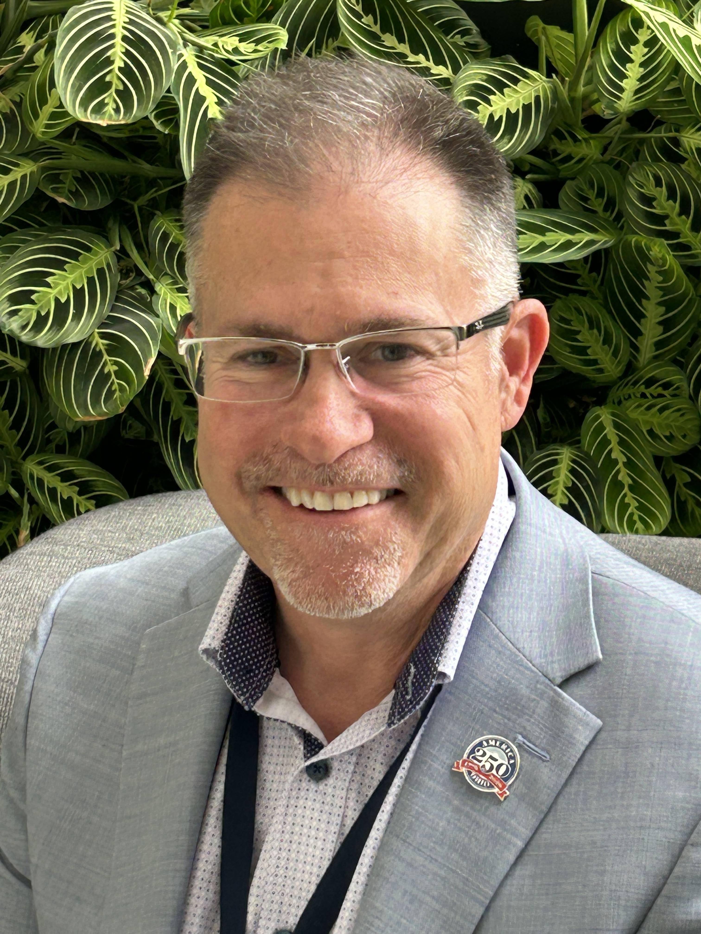
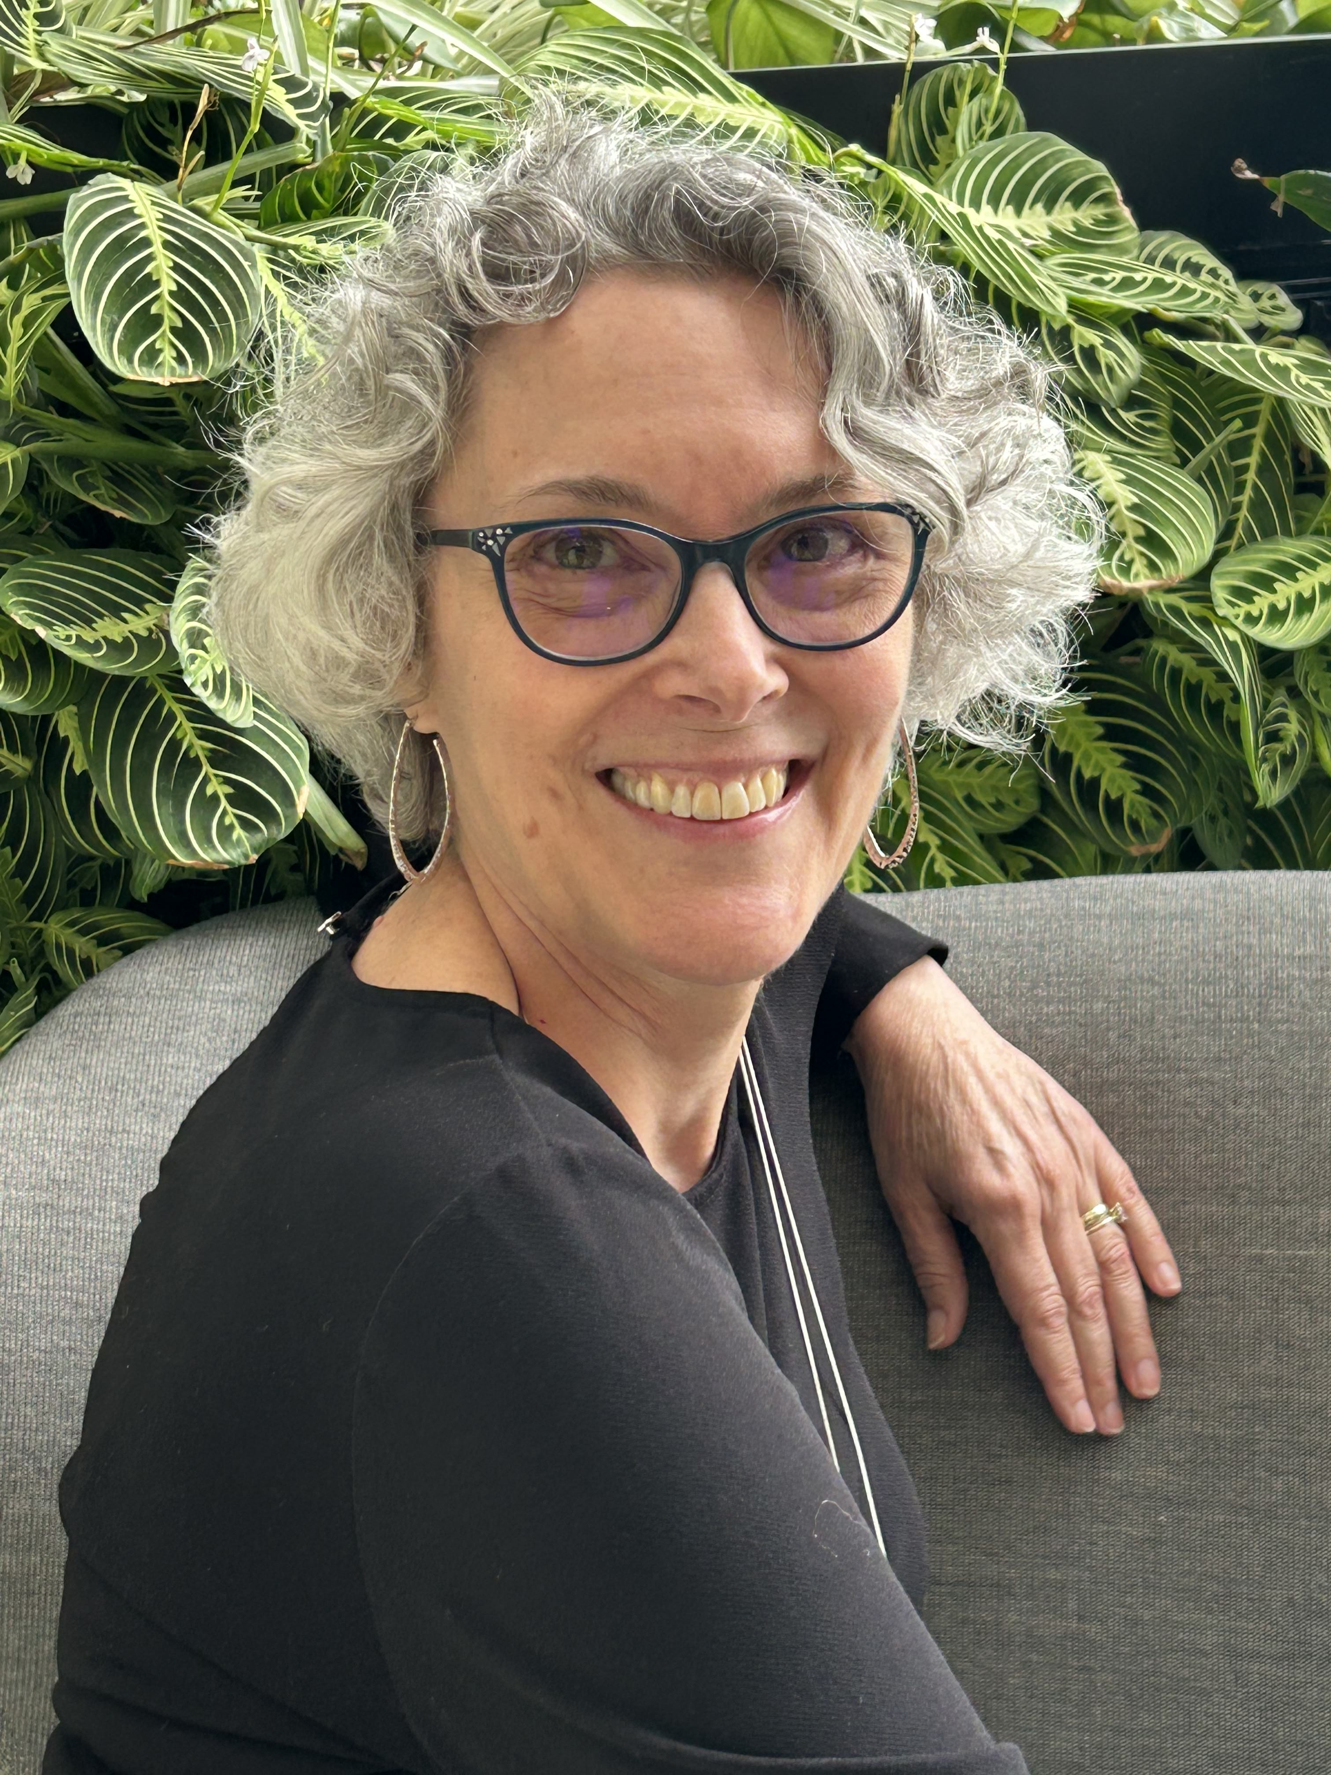
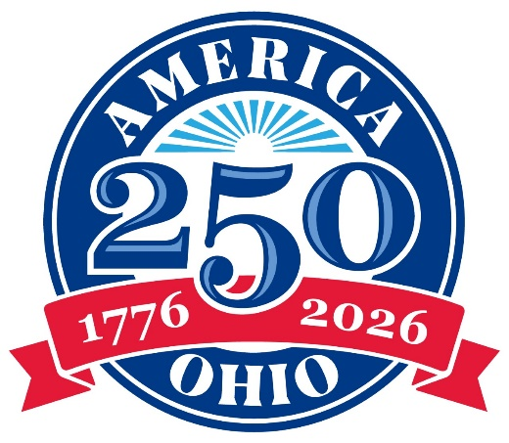
TODAY’S PRESENTERS
Todd Kleismit
Executive Director
America 250-Ohio
Chris Hurtubise
Communications Director
America 250-Ohio

Slide 4
OHIO REVISED CODE: THE OHIO COMMISSION FOR THE U.S. SEMIQUINCENTENNIAL
“…to plan, encourage, develop, and coordinate the commemoration of the two hundred fiftieth anniversary of the founding of the United States and the impact of Ohioans on the nation’s past, present, and future.”
Ohio Revised Code (149.309)
Notes:
In 2021, the Ohio Assembly passed Ohio Revised Code 149.309 forming the Ohio Commission for the Semiquincentennial – we have shorthanded it to America 250-Ohio (easier to say!). The charge of the commission it to plan…(then read slide).

Slide 5
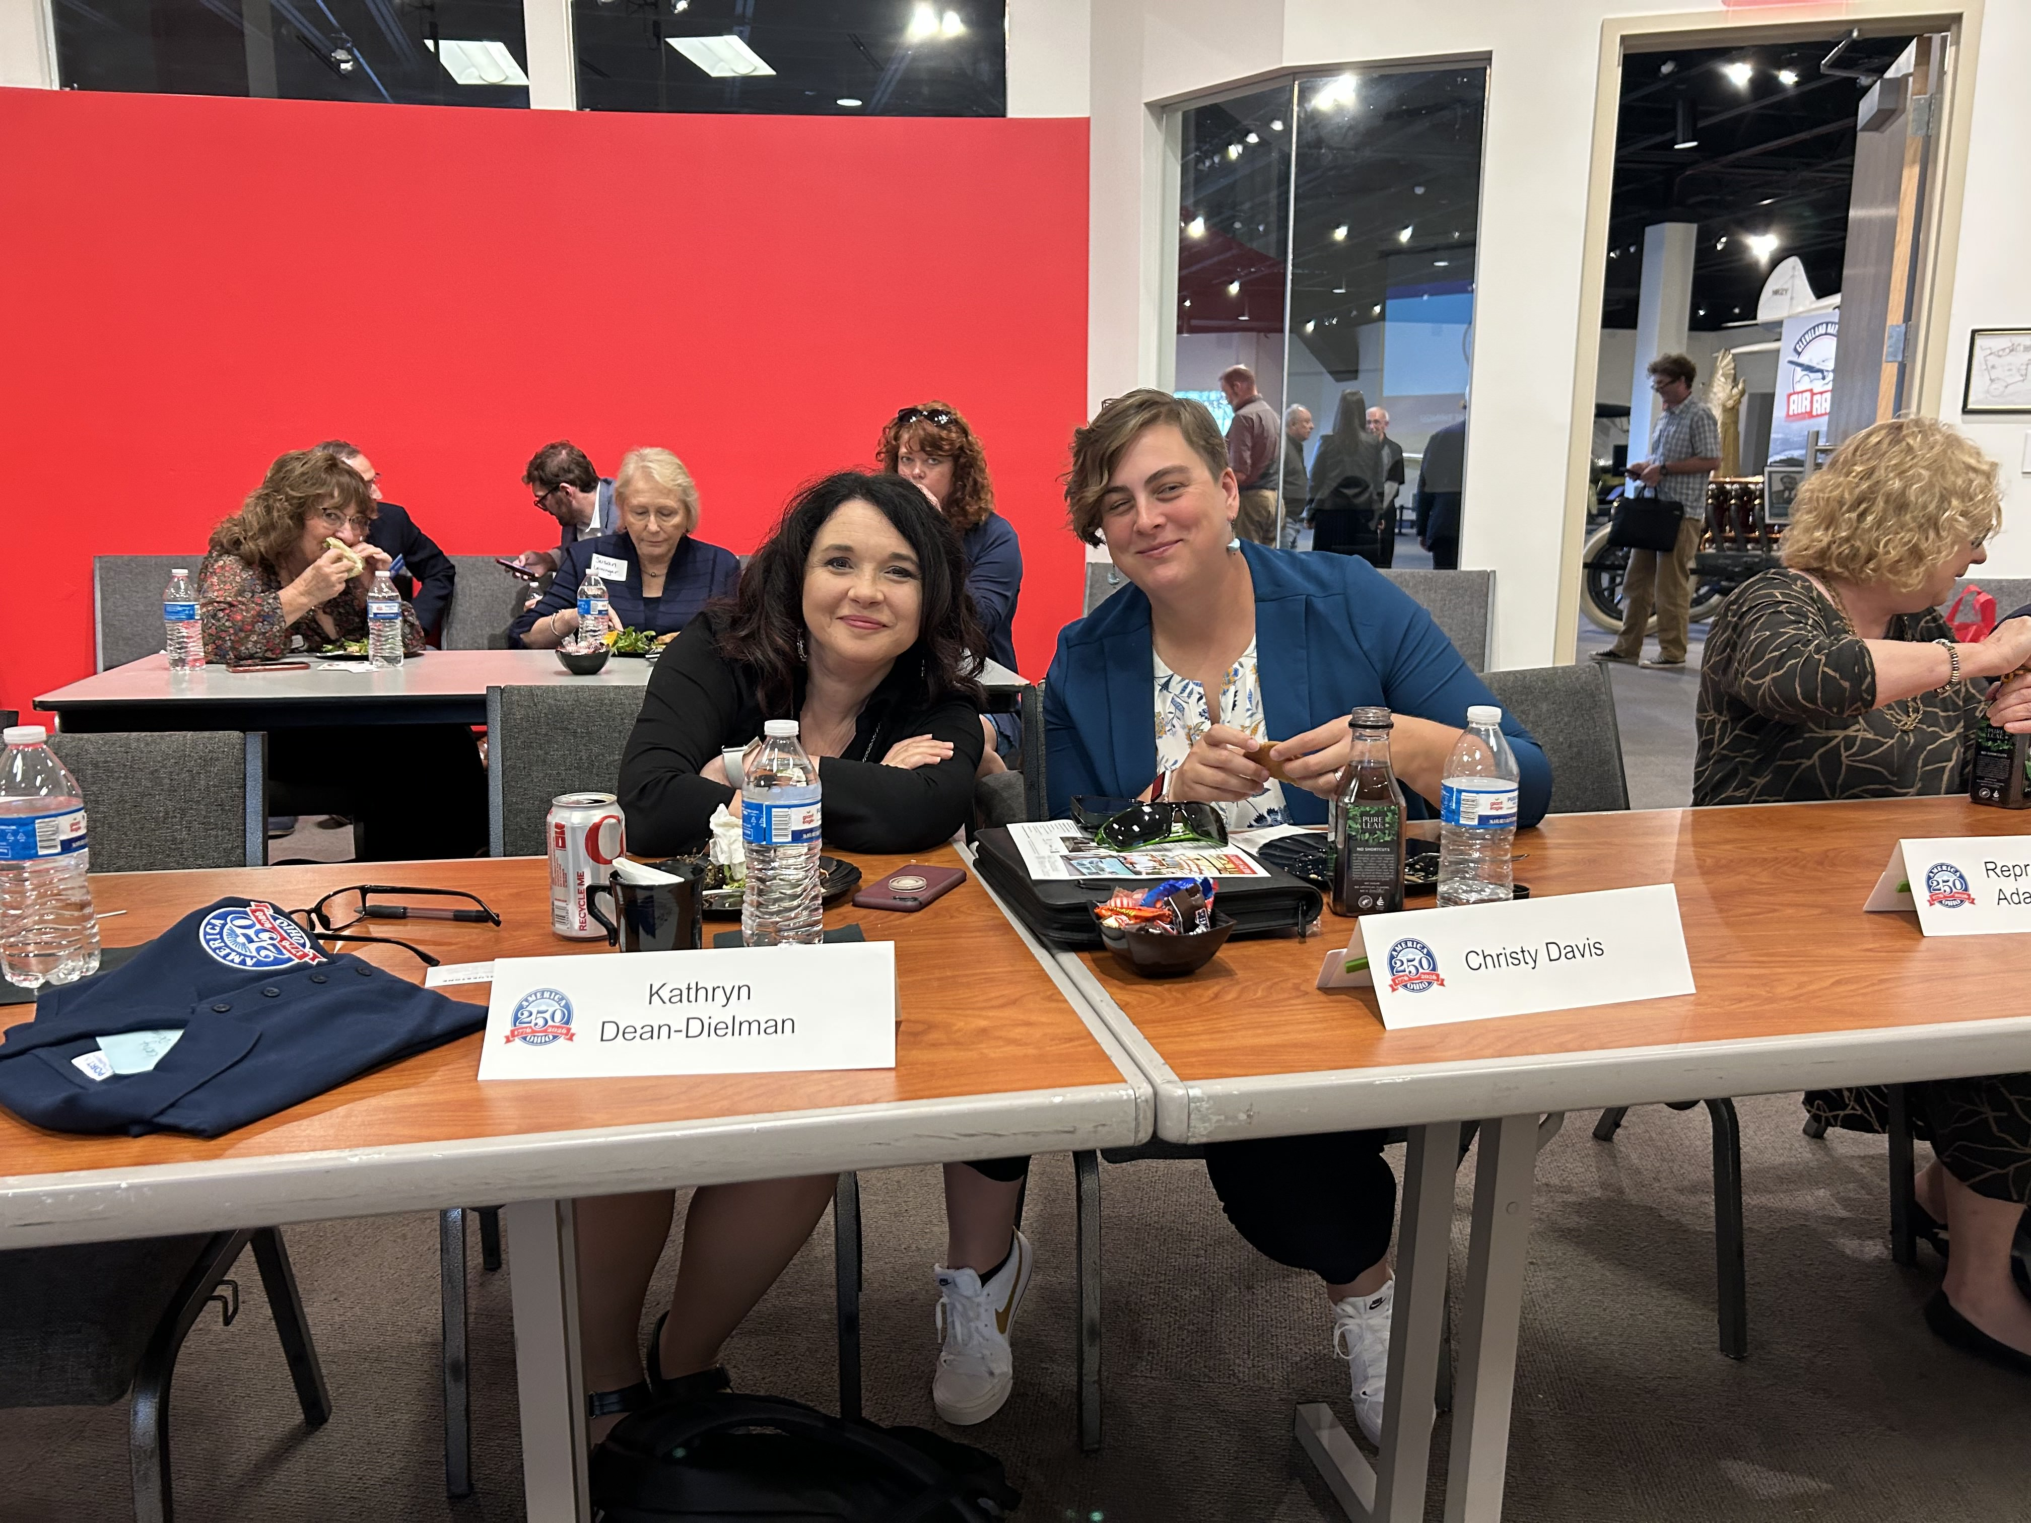
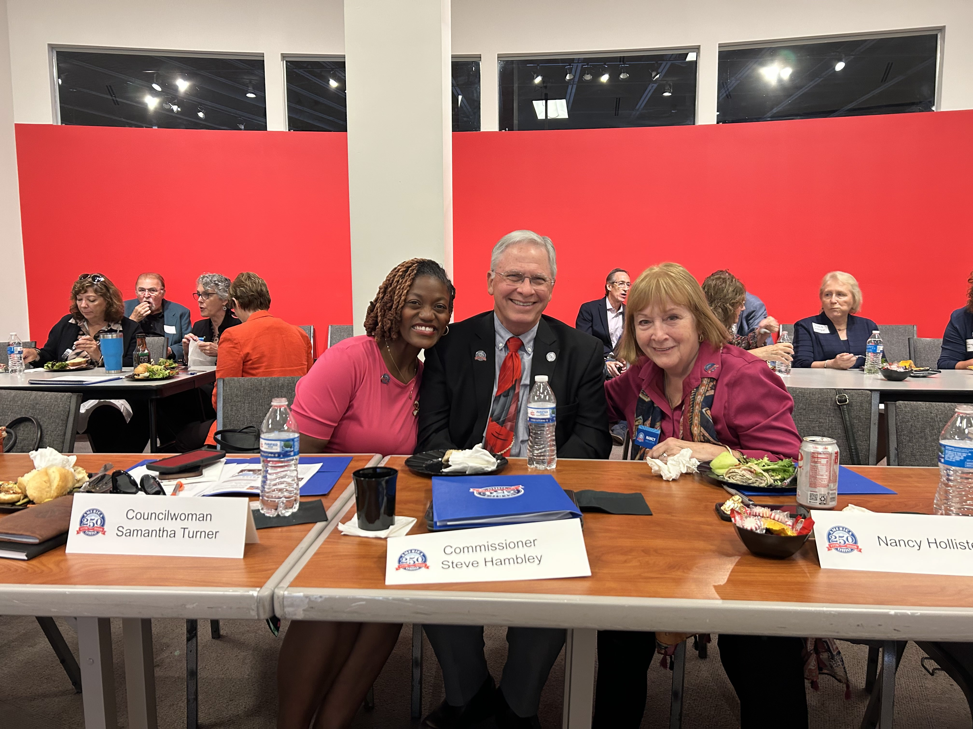
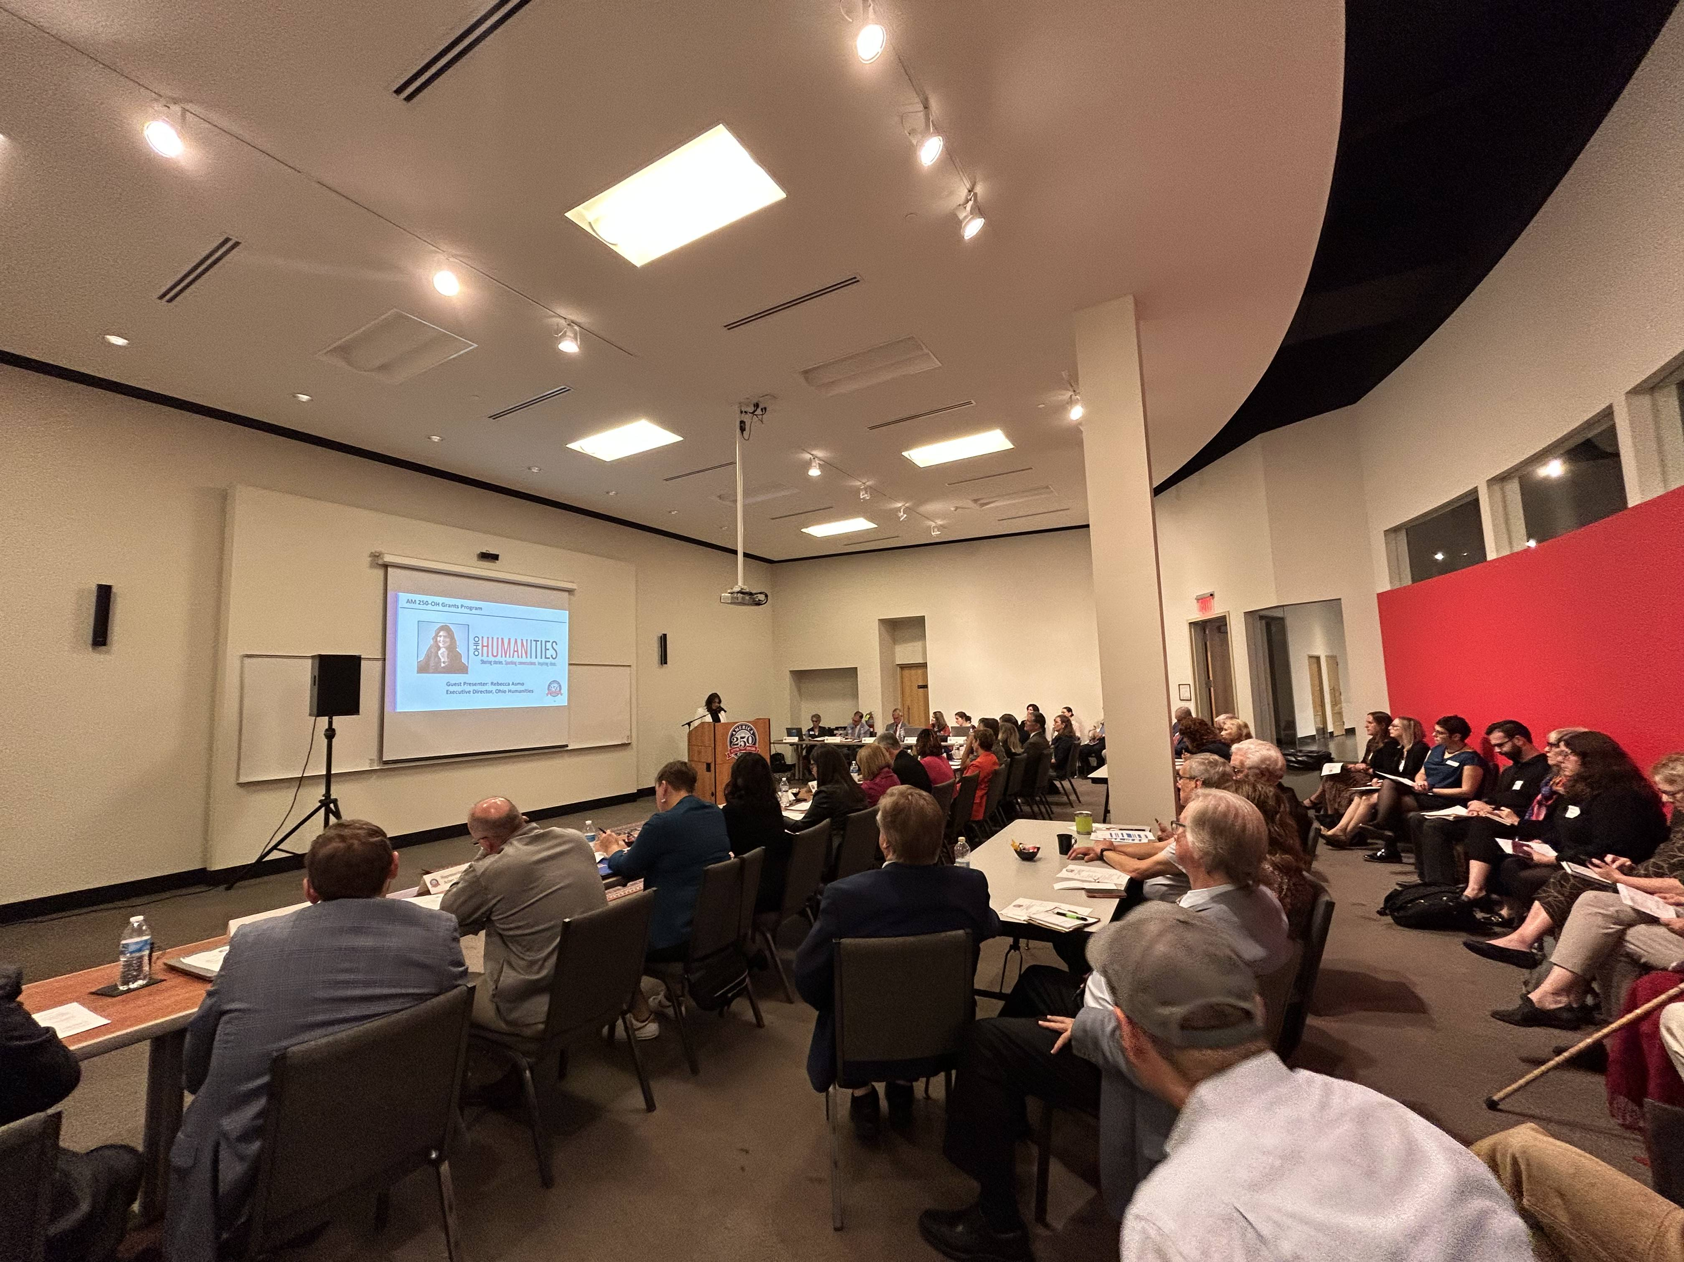
AMERICA 250-OHIO COMMISSION:
29 Appointed Commissioners and one ex-officio member
Quarterly public meetings
Co-chairs: Michael B. Coleman and Douglas J. Preisse
Notes:
The commission has five key goals (ready from the slide).

Slide 6
STRATEGIC INITIATIVE CATEGORIES
BUILDING BLOCKS
88 county engagement and support
Statewide signature events and programs
Education
Public awareness strategy
Programs and projects produced with partners
Grants program to distribute funds for projects and community-led initiatives
Tourism, industry, stakeholder, and community-led events
Lead to Inspire:
planning, communication, and logistics.
Partner to Expand
mutual impact, resources, and ideas.
Support to Foster Participation of the public and organizations.

Slide 7
KEY GOALS:
Engagement - build public awareness and foster public participation.
Connecting dots - across all levels of government and private organizations to include infrastructural improvements and projects or programs to welcome and encourage regional, national, and international tourists.
Statewide - involve and showcase all 88 counties.
Comprehensive - draw attention to the achievements, struggles, honors, innovations, and significance of all people in Ohio from before its founding to the present day.
Resources – providing resources such as grants, expertise and
promotional materials.
Notes:
The commission has five key goals (ready from the slide).

Slide 8
OUR KEY MESSAGE​
To tell the story of Ohio's contributions to the U.S. for the past 250+ years and create a sense of pride about the impact that Ohio and Ohioans
have on the state, nation, and the world.​
Notes:
In the state of Ohio, we are gearing up for the anniversary with the America 250-Ohio commission – a group of 30 commissioners plus paid staff who are preparing to make Ohio’s celebration truly special and memorable.

Slide 9
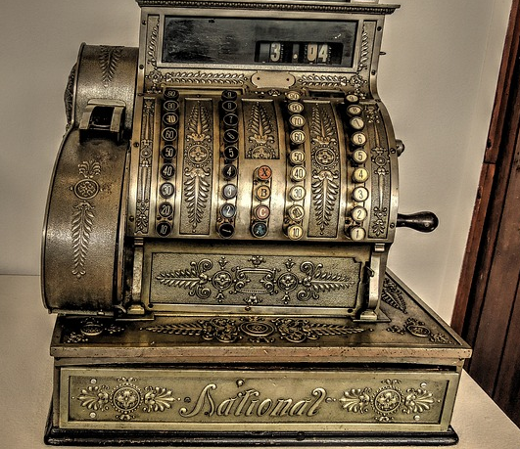
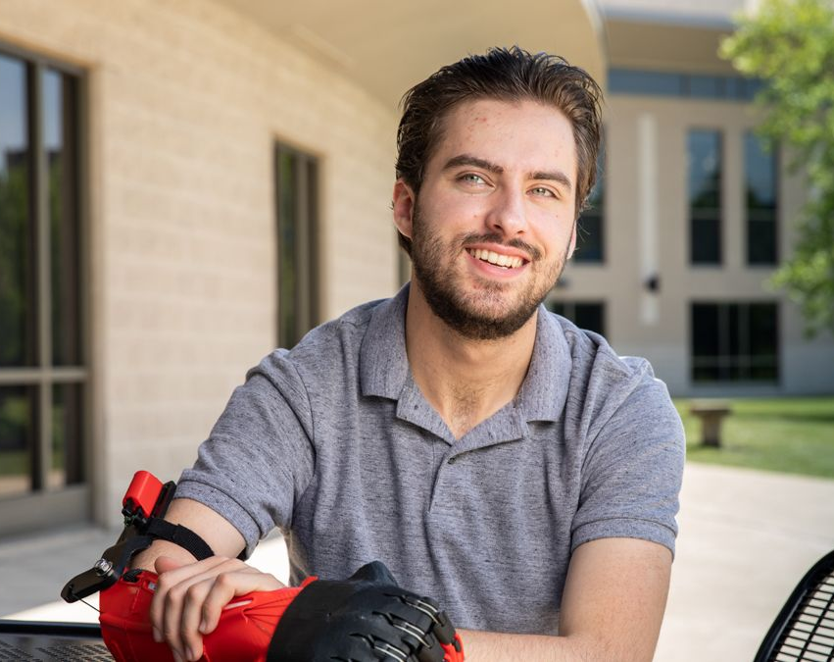
Through the America 250-Ohio projects, Ohioans will understand the impact that Ohio has had on them, the United States, and ultimately the world.
Notes:
You just saw that Ohio may look really small compared to the United States and even the rest of the world. But what you may not know is what an amazing impact that Ohio and Ohioans have had both in the U.S. but also around the world. Because of Ohio, our lives are changed and better.
Imagine what the world would be if Ohioan Thomas Edison had not invented the light bulb?
We can fly anywhere in the world thanks to Ohio natives Wilbur and Orville Wright who invented airplanes
Our lives are made richer by performers like Springfield Ohio native John Legend who has entertained audiences all over the globe.
Another pair of brothers, James and John Ritty from Dayton, Ohio who invented the cash register
We all are safer at intersections thanks to Cleveland resident Garrett Morgan, an African American inventor who created and patented the first practical traffic light in 1923.
But innovation isn’t just from the past, the young man in the lower left corner is Aaron Westbrook from New Albany, Ohio. Aaron was born with a birth defect on his right arm. In high school, Aaron created a 3-D printed prosthetic hand. He recognized that 3D printed prosthetics could be a solution for better fitting and more affordable alternative. By the time he was 18 he had created Form5 Prosthetics.
And here’s an innovation we all love – did you know that Pop-Tarts are originally from Ohio? Yep, it was created in 1964 in Ohio!
Needless to say, we have so many great stories to tell!

Slide 10
AMERICA 250-OHIO INITIATIVES WILL TELL THE STORIES OF OHIO
Stories that will be developed and shared using these values:
Contributions – People sharing their Ohio stories (personal, family, organization, community)
Collaboration – People working together to tell the stories
Commemoration – People telling stories that are under-told, difficult, or nuanced
Celebration – People celebrating milestones and moments.
Past
Present
Future
Interpretation
Celebration
Commemoration
Heritage
Reflection
Preservation
Education
Building for the next generation
Notes:
The word “history” has the word “story” embedded in it. For Ohio the story is going to focus on people – all of us – because together we are Ohio. The programs and initiative we create will tell stories and will be developed collectively by using the values of Contribution, Collaboration, Commemoration, and Celebration.

Slide 11
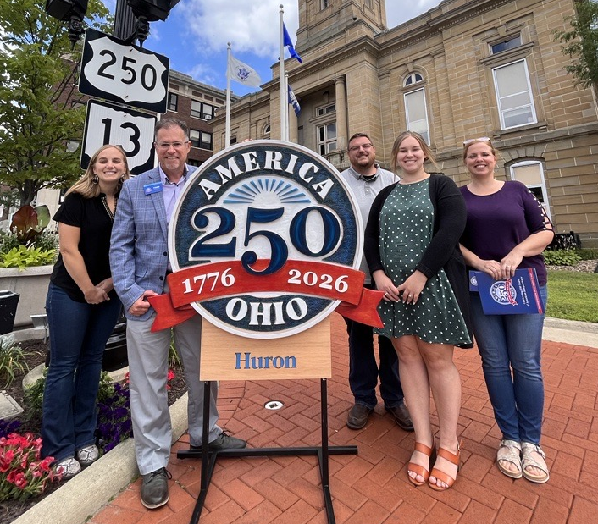
KEY INITIATIVE AREAS
Celebrations and Signature Events
Ohio Originals – Highlighting Ohio firsts, points of pride and unity
Engaging Youth and Lifelong Learners – Developing educational touchpoints
Inclusive Statewide Engagement – History, Arts, Culture, Museums, & People
Telling Ohio’s Stories – Highlighting under-told stories

Slide 12
PROJECTS FOR 2023-2024
New website: america250-ohio.org

Slide 13
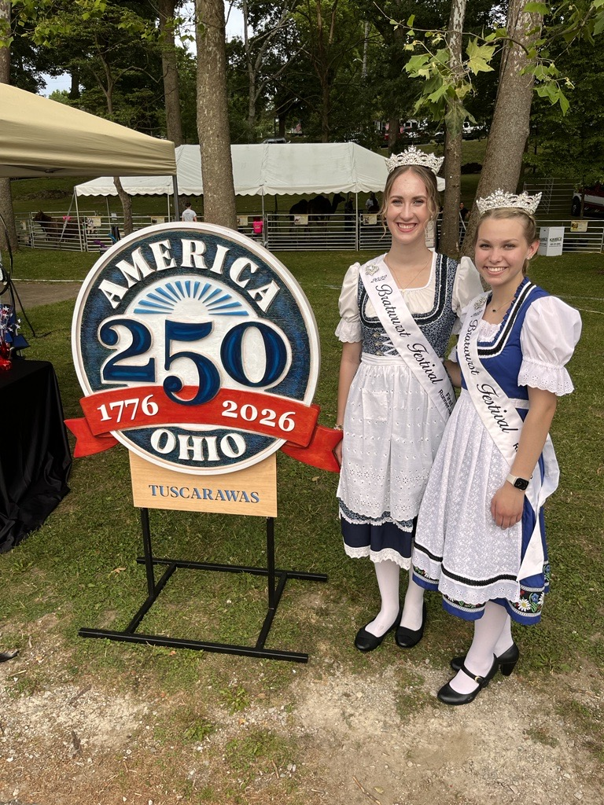
AMERICA 250-OHIO COMMUNITIES
A special designation for counties, cities, villages, and townships
Opportunity for local leaders to network and coordinate AM 250-OH activities
Recognition as an AM 250-OH community
Signage
Website listing on America250-Ohio.org
Social media support
Access to resources
Toolkits
Online community platform
Opportunity to collaborate with other AM 250-OH communities.
Simple to activate
Apply to become an AM 250-OH community
Pass a resolution to support
Form an AM 250-OH committee
Plan your events leading up to 2026!
Bucyrus Bratwurst Festival Queens – New Philadelphia First Town Days-2023

Slide 14
250 OHIO’S FAVORITES PROMOTION
Launched October 5, 2023
Individuals, organizations, convention & visitors bureaus, government entities can submit ideas.
Crowd-sourced and curated (not a contest)
New topics every few weeks
Post/share/like and participate on AM 250-OH social media sites.
Social media promotion to engage Ohioans to share their favorites across a broad spectrum of topics to create an engaging way for Ohioans to share their favorites…

Slide 15
AMERICA 250-OHIO GRANTS PROGRAM
The America 250-Ohio grants program will be launched on October 16, 2023
Ohio Humanities is managing the grants application process on behalf of America 250-Ohio
Two funding levels: up to $5,000 and $5,000- $50,000
Two separate cycles: October 2023 and January 2024
Grant funding pool of approximately $1 million in
FY 2024 in support of local and statewide programs and projects related to America 250-Ohio themes. ​

Slide 16
NEXT GEN CITIZENS – Youth Engagement Program
An activity passport program for youth grades 4-12th.
Their exploration guide to explore Ohio’s history and learn more about their families, neighborhood, and themselves.
Summer 2024 – Pilot program with Columbus Metropolitan Libraries.

Slide 17
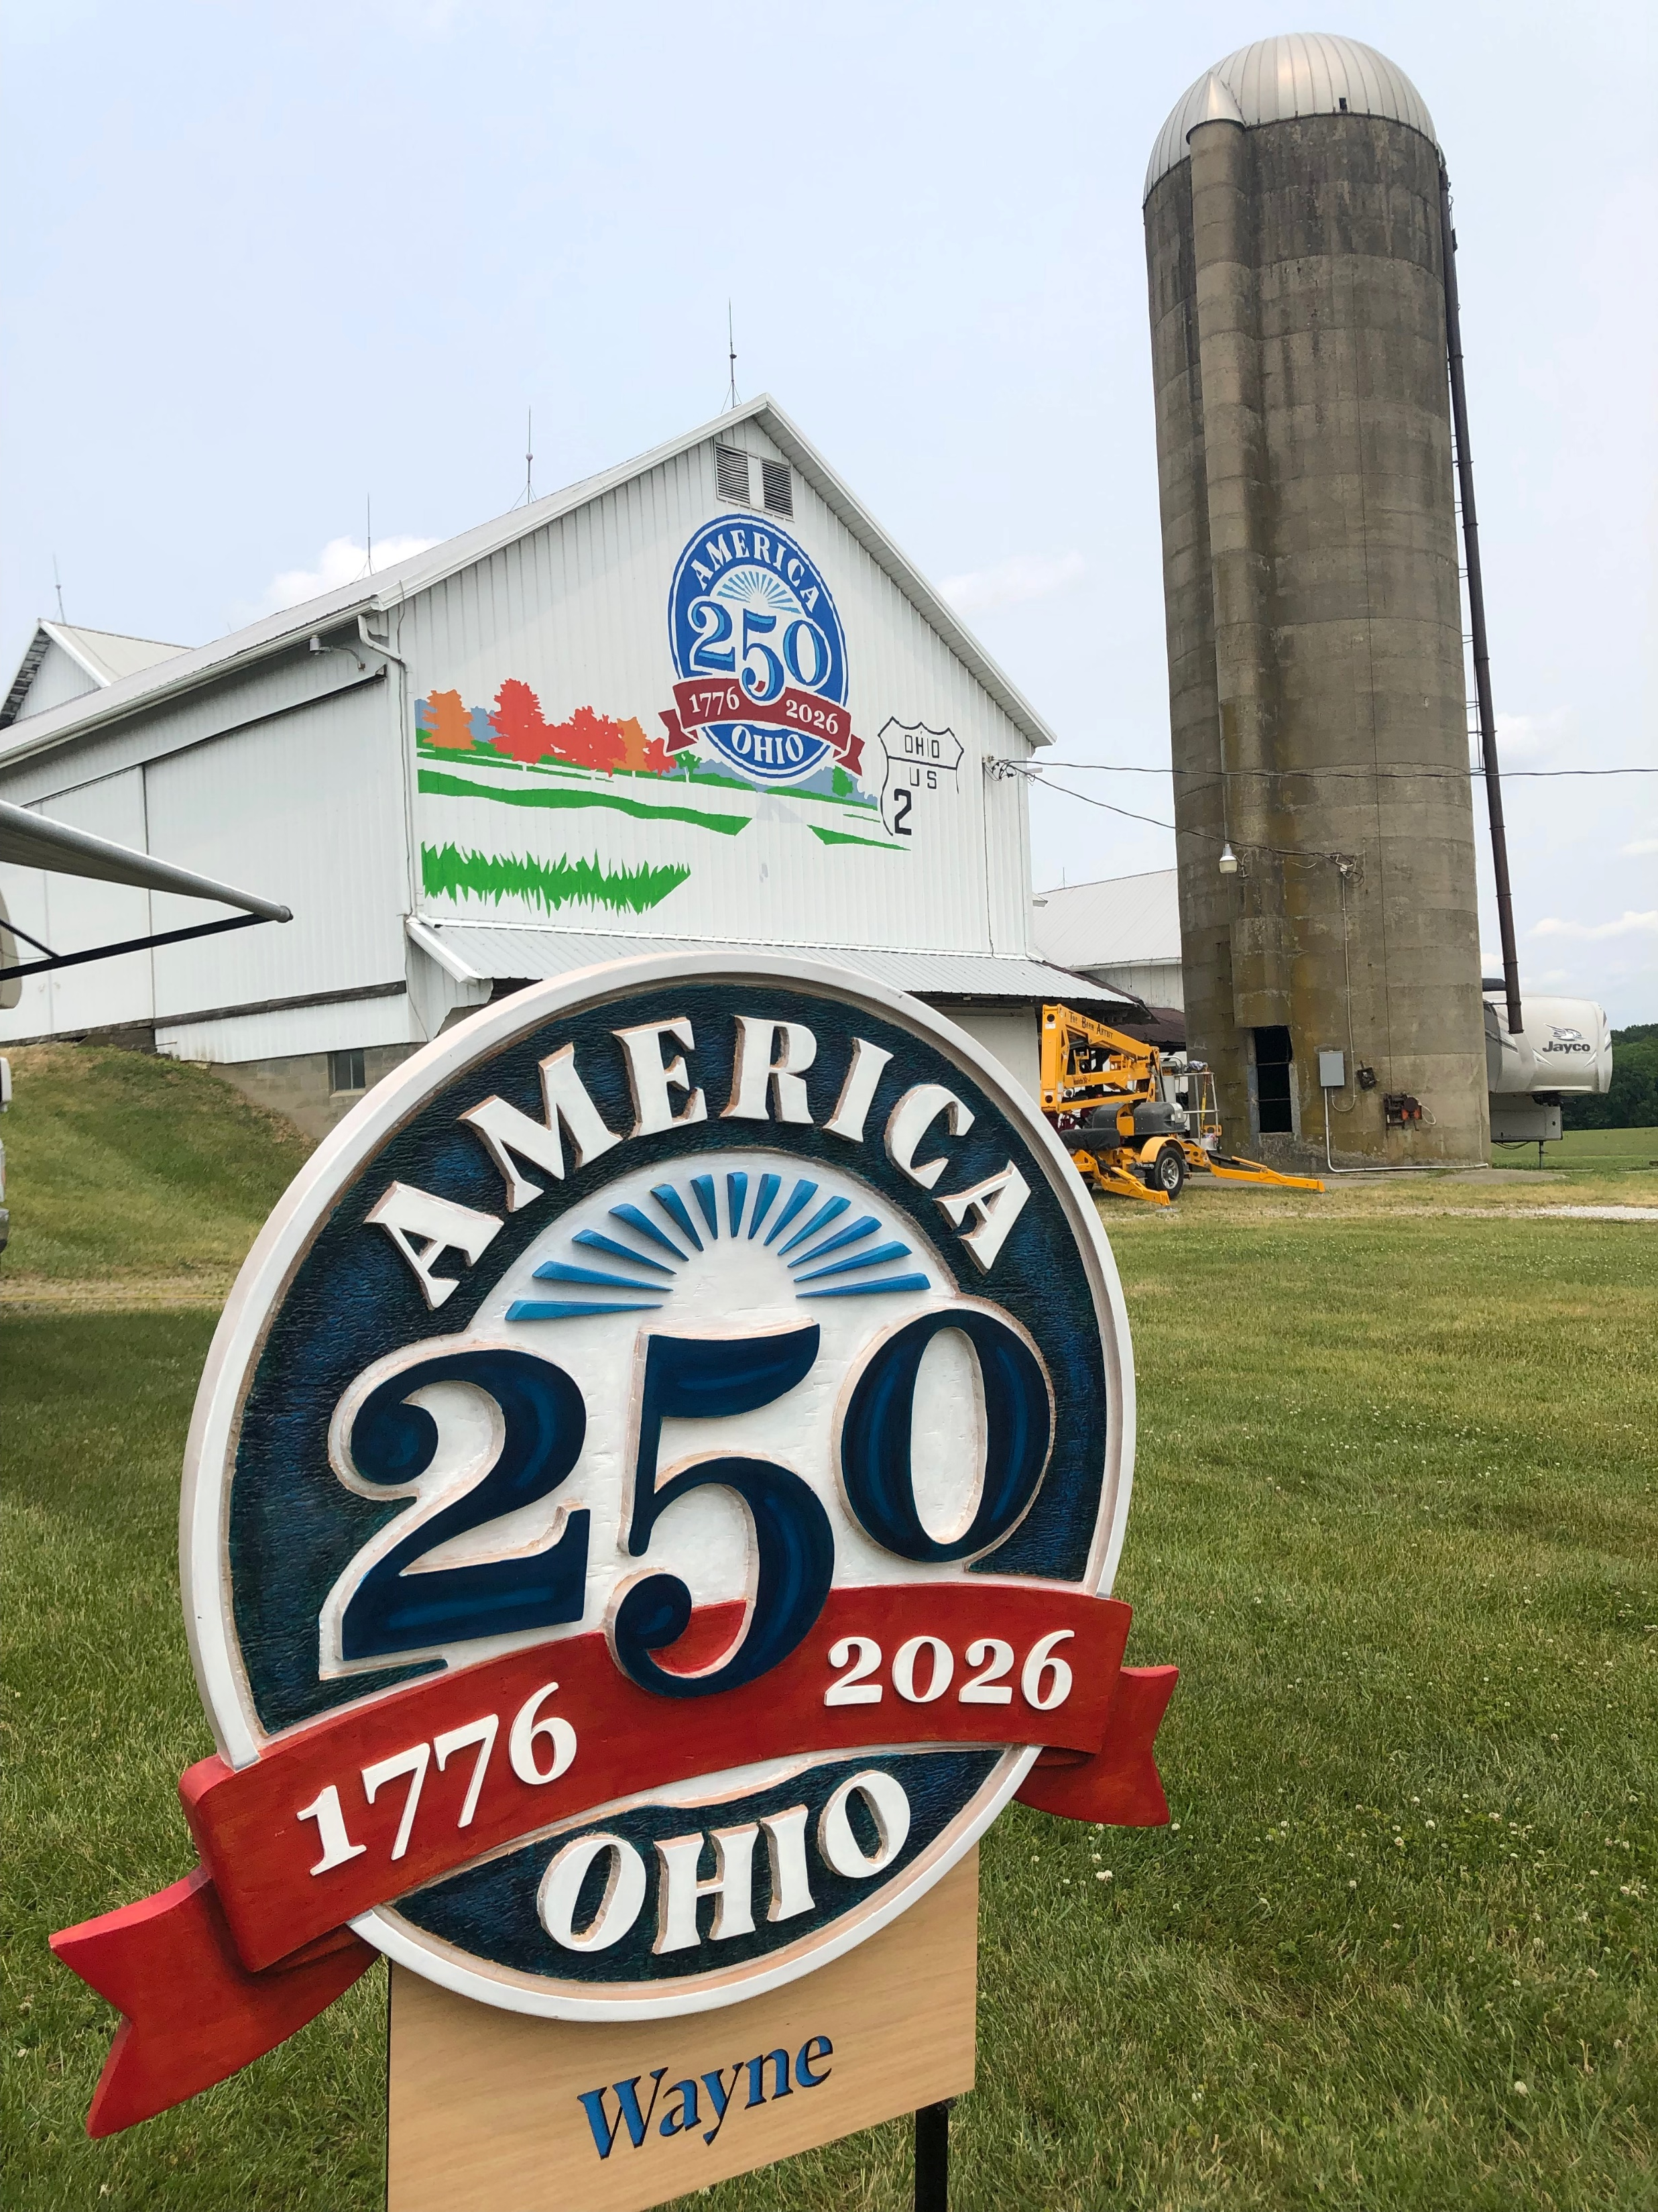
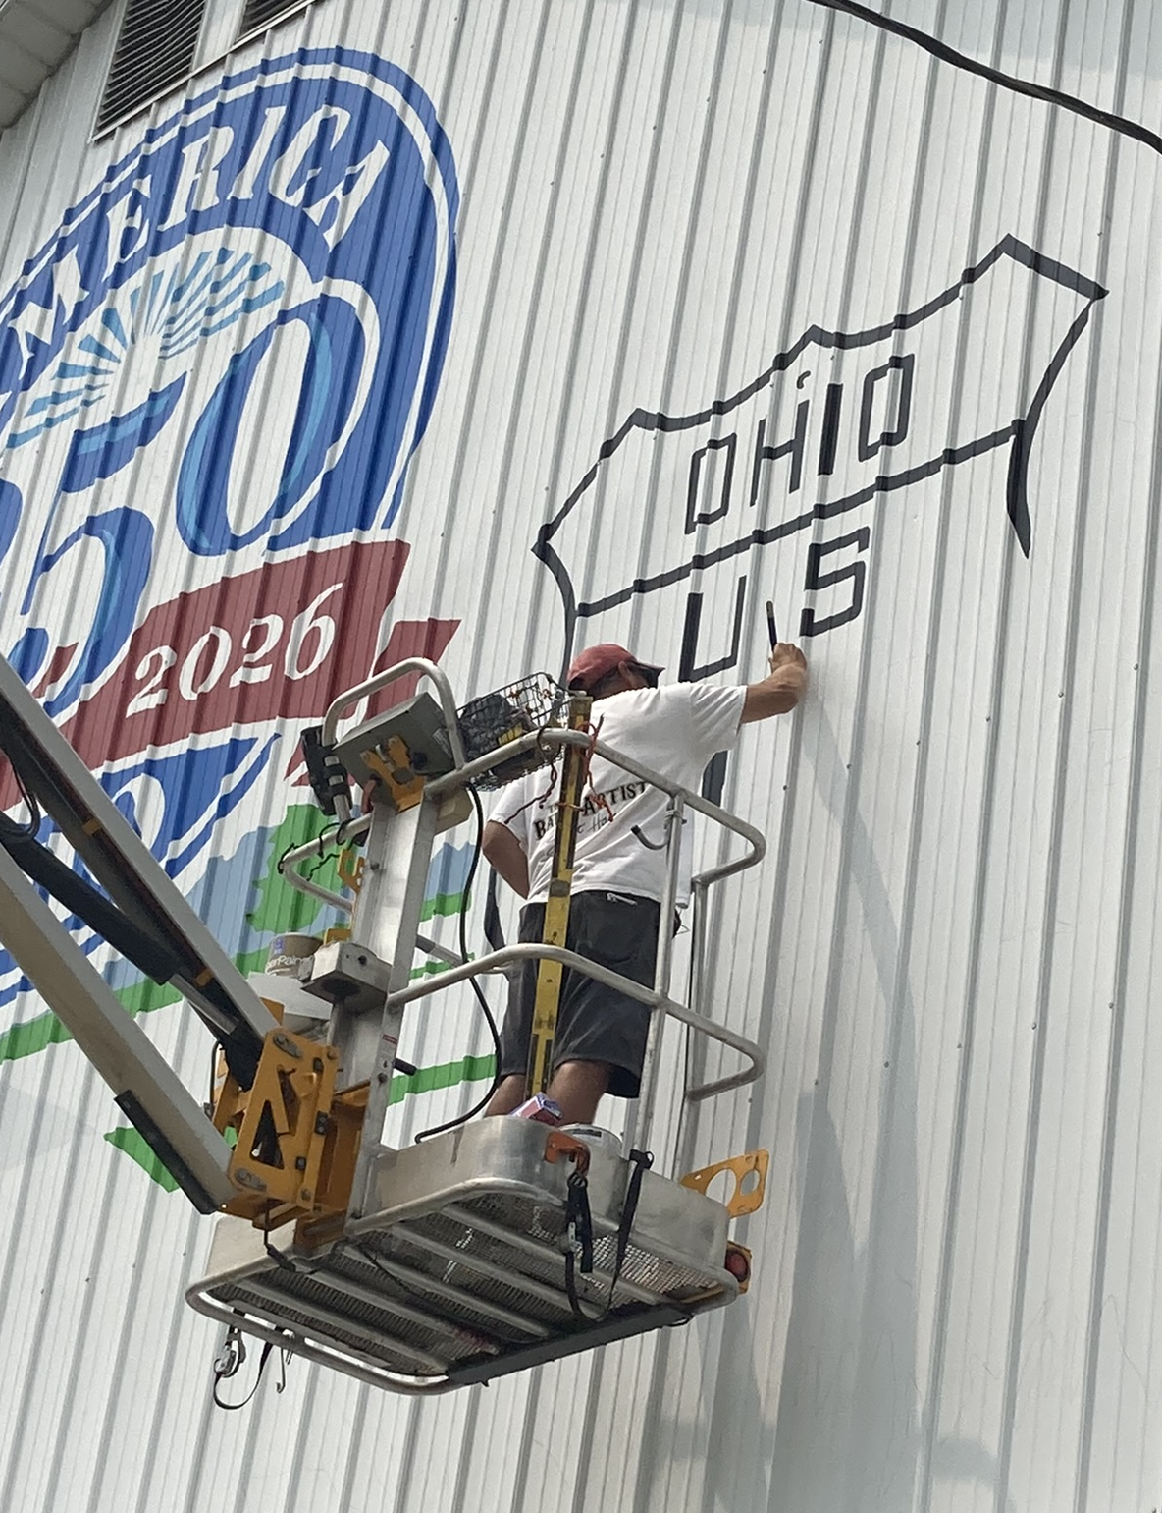
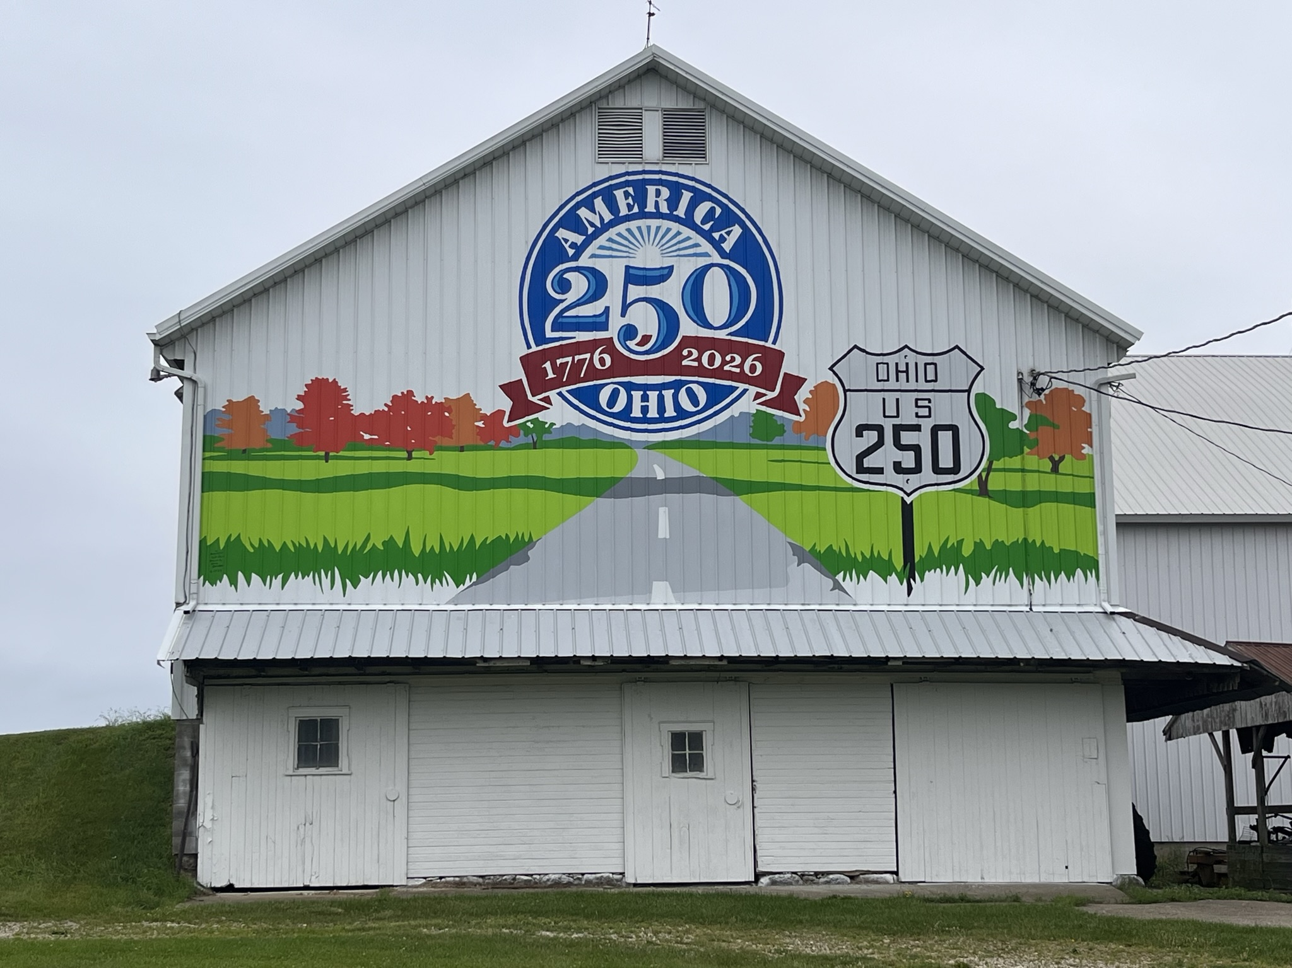
BARNS, URBAN MURALS & PUBLIC ART

Slide 18
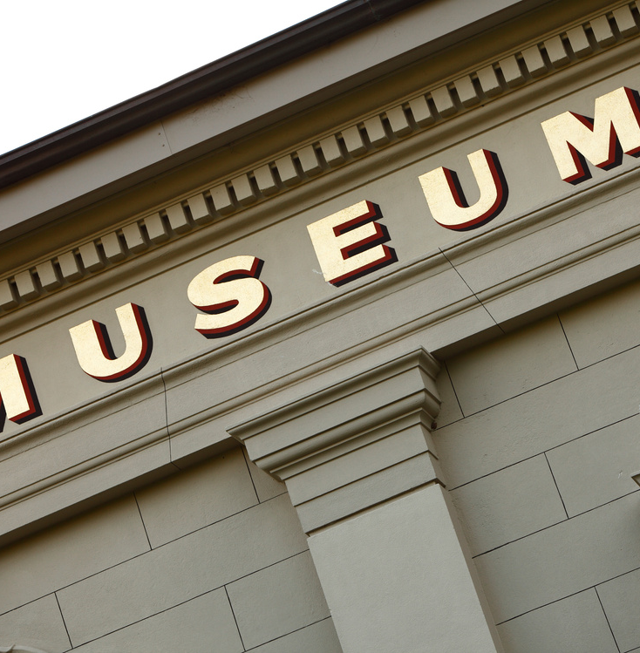
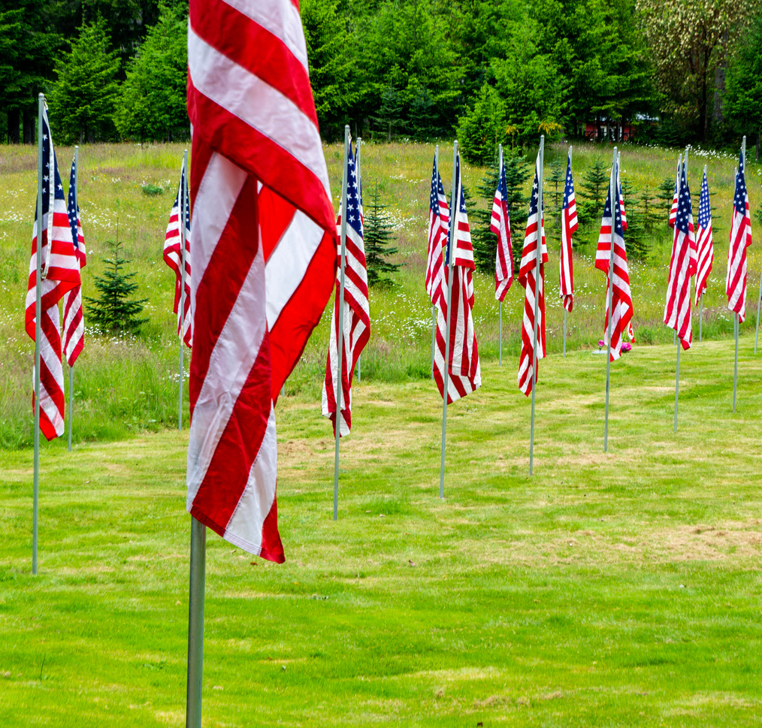
FUTURE PROJECTS AND INITIATIVES 2024 - 2025
4th Grade History Pass
Introduce first three statewide trails
Revolutionary War Veterans grave markers
Tree planting
Ohio Story Hub
Ohio statewide film festival

Slide 19
FUTURE PROJECTS AND INITIATIVES – 2026
Celebrating Ohio's Contributions to the U.S. for 250+ years...
We are creating monthly themes for 2026 that celebrate different aspects of Ohio’s contribution. Each monthly theme can include events, experiences, content highlights, and more.
January – Ohio Firsts & Originals
February – Inventions, Innovation, Business & Work
March – Music & Entertainment
April – Transportation: Planes, trains & automobiles (and more!)
May – Arts & Culture and Movies
June – Natural Resources
July – The Ohio statewide picnic & homecoming
August – The Ohio state fair and county fairs
September – Sports
October – Agriculture
November – Veterans and First Responders
December – Future Ohio

Slide 20
Trails, Tales and Two-Fifty
Notes:
You can stay in touch by following our social media channels or visiting our website.

Slide 21
TRAILS AND TALES: CONNECTING OHIO’S PAST AND PRESENT
Opportunity:
Ohio’s Trails and Tales will Illuminate Ohio's unique historical narrative and its influence on the United States over the last 250+ years, using imaginative storytelling and themed trails.
Inspiration:
Our hope is for you to leave here feeling inspired to share your stories and to become actively involved in the statewide trail initiative.
Notes:
You can stay in touch by following our social media channels or visiting our website.

Slide 22
OUR GOAL: 12 STATEWIDE TRAILS BY 2026
The Big Idea:
Create statewide trails with places visitors can visit, engage, and learn first-hand about Ohio and Ohioans.
Engaging the senses:
Guests will be able to hear the voice of Ohioans through technology that ties in with smartphone GPS.
Discovery:
Venues can add to the storytelling with exhibits, signs, interpreters, docents, etc.
Trails and the related tales will align with the 2026 monthly themes, will be accessible and inclusive.
The first 3 trails will launch in 2024.
Notes:
You can stay in touch by following our social media channels or visiting our website.

Slide 23
COLLABORATIVE EXPLORATION
Identify your existing stories and trails that can be integrated into a statewide thematic trail.
1
Dive into historical records, archives, and local stories to gather content.
2
Seek input from residents, businesses, & cultural institutions to create a sense of ownership and pride.
3
Collaborate with neighboring entities & regions to continue the story with stops all through the state.
4
Notes:
You can stay in touch by following our social media channels or visiting our website.

Slide 24
DESIRED OUTCOMES
The ultimate goal is to establish an inclusive platform for narrating Ohio's story in an exciting, engaging, and memorable way. Positively impacting visitation and economic impact for our communities, institutions, and the travel and tourism industry as a whole.
Additionally, that we receive active participation by you, in this initiative. We will provide a formal submission process for you to become part of a trail.
We will actively promote Trails and Tales through America250-Ohio.org and affiliated partner websites.
Notes:
You can stay in touch by following our social media channels or visiting our website.

Slide 25
GROUP PROJECT: PAIR AND SHARE
Get into groups of 2-3 people at your table
Think about experiences and stories that could illustrate trails based on the following themes:
Ohio Firsts & Originals
Inventions, Innovation, Business & Work
Music & Entertainment
Transportation: Planes, trains & automobiles (and more!)
Arts & Culture and Movies
Natural Resources
The Ohio statewide picnic & homecoming
The Ohio state fair and county fairs
Sports
Agriculture
Veterans and First Responders
Future Ohio
Or your own theme!
Write some of your ideas down on the index cards at your table
Share a few ideas with the larger group in a few minutes.
Notes:
You can stay in touch by following our social media channels or visiting our website.

Slide 26
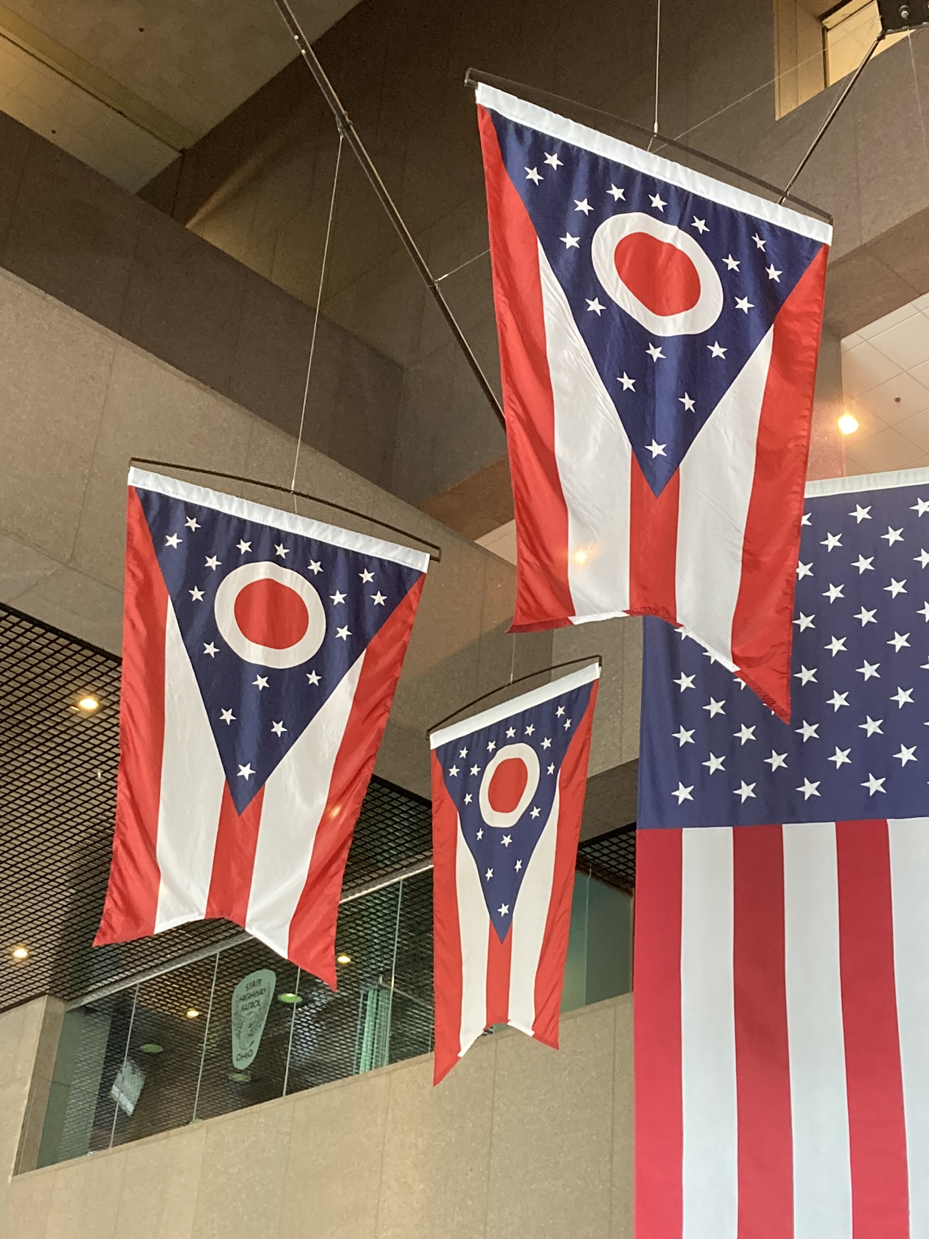
OPPORTUNITIES FOR PERSONAL ENGAGEMENT
Provide America 250-Ohio with information on any programs and help promote America 250-Ohio with your colleagues and the public.
Volunteer opportunities:
Planning committees (local level)
Community events
Follow and engage America 250-Ohio on social media
Sign-up for America 250-Ohio e-newsletter to keep informed about updates
Notes:
How can you personally get involved?
Here are some ideas (read slide)

Slide 27
COMMUNITY INVOLVEMENT OPPORTUNITIES
Leadership in county engagement – advocate with your County Commissioner and other organizations to get involved with America 250-Ohio.
Ohio Untold Stories – Help identify, collect, and share the stories of diverse and under-represented Ohioans.
Help your constituents discover their stories with your resources through educational and community outreach
Work with local history organizations including the DAR/SAR chapter in your area.
Provide America 250-Ohio with information on any programs and help promote America 250-Ohio with your colleagues and the public.
Notes:
Here are some ways you can get involved at the community level.

Slide 28
STAY INFORMED – FOLLOW US!
@America 250-Ohio
@am250ohio
@America 250-Ohio
#America250Ohio
https://america250-ohio.org
info@america250-ohio.org
Notes:
You can stay in touch by following our social media channels or visiting our website.

Slide 29
WE WILL BE CELEBRATING THIS ANNIVERSARY “OHIO-STYLE”
JOIN US!
Notes:
In the state of Ohio, we are gearing up for the anniversary with the America 250-Ohio commission – a group of 30 commissioners plus paid staff who are preparing to make Ohio’s celebration truly special and memorable.

