Slide 1
SPARKing Museums for All
Ohio Local History Alliance 2023 Conference
Ben Anthony & Alex Ingley

Slide 2
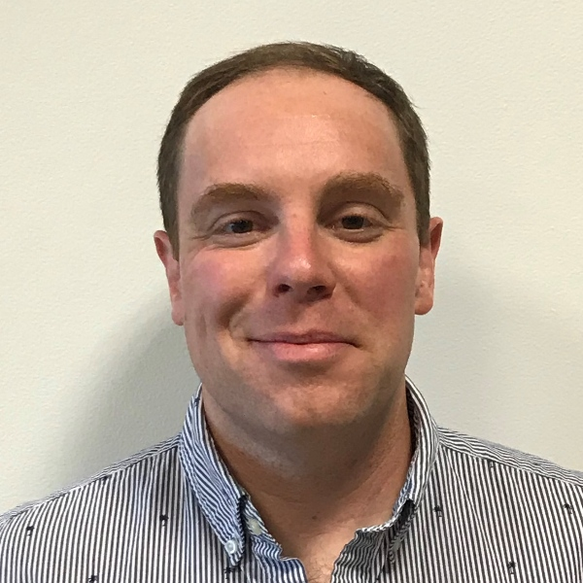
Hi! We are Alex and Ben
Ben Anthony
Manager, Community Engagement
Alex Ingley
Community Engagement Coordinator
Notes:
People in your space or People in their space

Slide 3
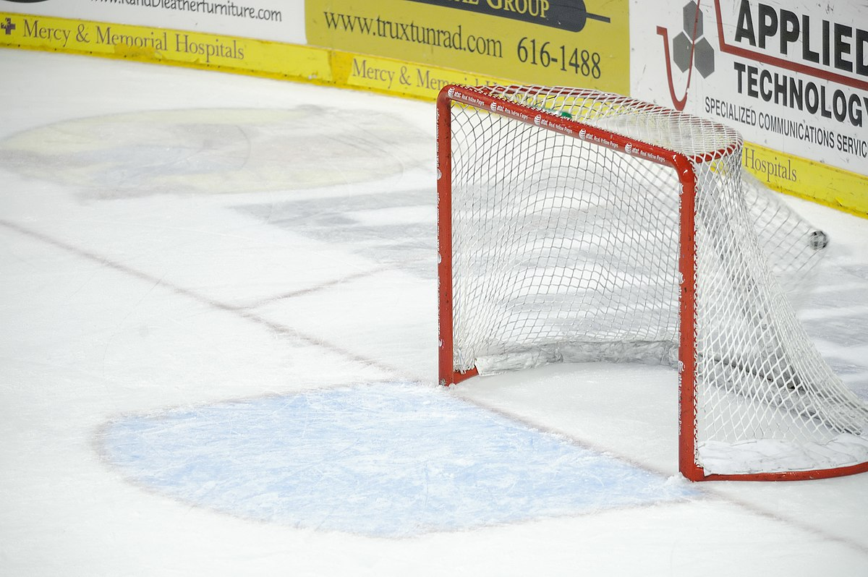
Goals!
Our goals for today’s presentation are…
Review the WWWHs of Museums for All (M4A).
Discuss your experiences of M4A.
Share Ohio History Connection’s Spark Membership.
Chat out a few guided questions.
Answer your questions!
Notes:
People in your space or People in their space

Slide 4
What is Museums for All?
National program focused on broadening museum accessibility.
Originally developed by the Institute of Museum and Library Services and the Association of Children’s Museum in 2014.
Families who are receiving food assistance (SNAP benefits) can gain free or reduced admission.
Free - $3 admission cost model.
Only nationally coordinated financial accessibility program in the museum field.
Notes:
People in your space or People in their space

Slide 5
What is SNAP?
Supplemental Nutrition Assistance Program (referred to as SNAP) is a nationally implemented program that “provides food benefits to low-income families to supplement their grocery budget so they can afford the nutritious food essential to health and well-being.”
Administered through the U.S. Department of Agriculture.
Originally designed as the Food Stamp Program (FSP) in 1939.
President Johnson solidified FSP as a permanent federal program by signing the Food Stamp Act of 1964.
Eligibility is based on 130% of the poverty level (either gross or net monthly income) and household size.
Notes:
People in your space or People in their space

Slide 6
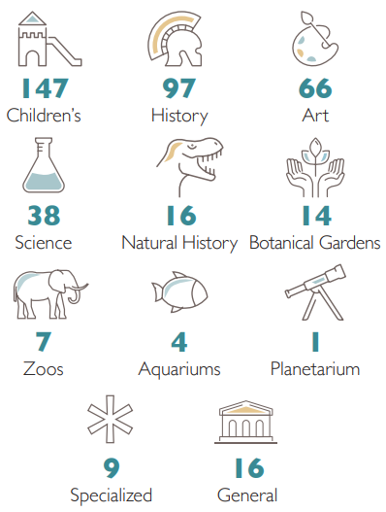
Who is Museums for All?
According to IMLS’s, there are over 1,200 participating M4A museums and cultural institutions.
Participating institutions represent all sectors of the museum field.
The “easy-to-implement structure and the ability for participating museums to customize their implementation” were intentional designs.
Notes:
People in your space or People in their space

Slide 7
Why Museums for All?
*According to IMLS…
Participating museums reported no negative financial or visitation impact.
More than 25% report increases in attendance, development revenue, and program/membership subscription.
20% reported significant shifts in visitor demographics and relationships because of M4A participation.
20% report unexpected positive benefits including:
Improved public perception.
Opportunities for community partner connections.
Internal dialogue on accessible and inclusivity practices.
*Sourced from a 2018 third-party impact evaluation
Notes:
People in your space or People in their space

Slide 8
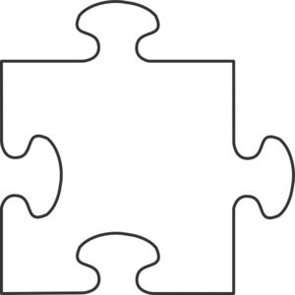
Why Museums for All?
Social impact of museums
Relevancy
Sustainability
Increasing rates of poverty amongst families.
Museums for All income eligibility increase.
Positive impact of early access to informal learning opportunities on child development and academic performance.
Impact of poverty on educational outcomes.
Notes:
People in your space or People in their space

Slide 9
How Museums for All Works
Participating institutions decide their per-ticket cost admission price (free to $3).
Museums are required to track M4A admission and report quarterly to IMLS.
*Determine outreach and marketing efforts.
*Determine SNAP eligibility verification process.
Explore potential opportunity to become a Hub City.
Notes:
People in your space or People in their space

Slide 10
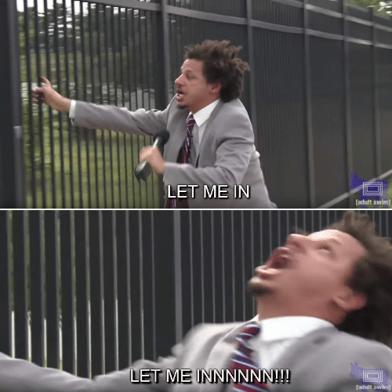
Let’s Discuss: How is Museums for All working for you?
Do you utilize Museums for All?
What is going well?
What challenges have you faced?
Do you have other programs to address access? How do they work for your museum?

Slide 11
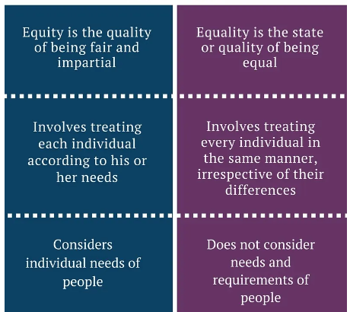
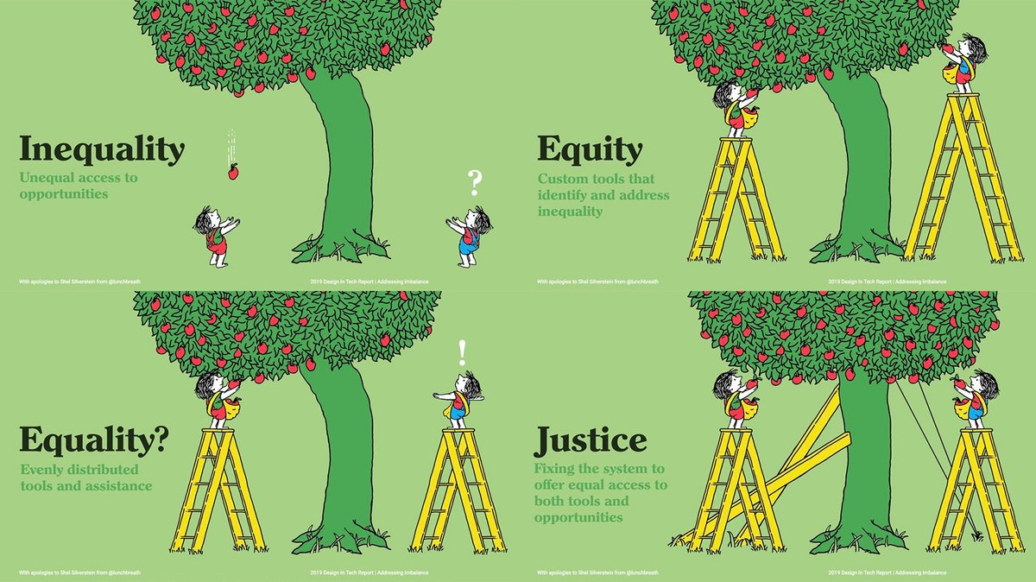
When Museums for All Isn’t Working

Slide 12
When Museums for All Isn’t Working
Income is not the only barrier to museum accessibility.
Social Determinants of Health affect the ability for an individual or household to visit a museum.

Slide 13
Museums for All: Columbus as a Hub City
Museums for All isn’t working as well as it should in Columbus
In 2021, Central Ohio’s museums and cultural institutions decided to team up to see if we could find ways for people to utilize the program and access our institutions
Columbus Foundation Helped Seed and Kick-off Understanding
Still Very Much an Experiment in Process
IMLS National Leadership Prototyping Grant
Cohear Listening about Marketing
Notes:
People in your space or People in their space

Slide 14
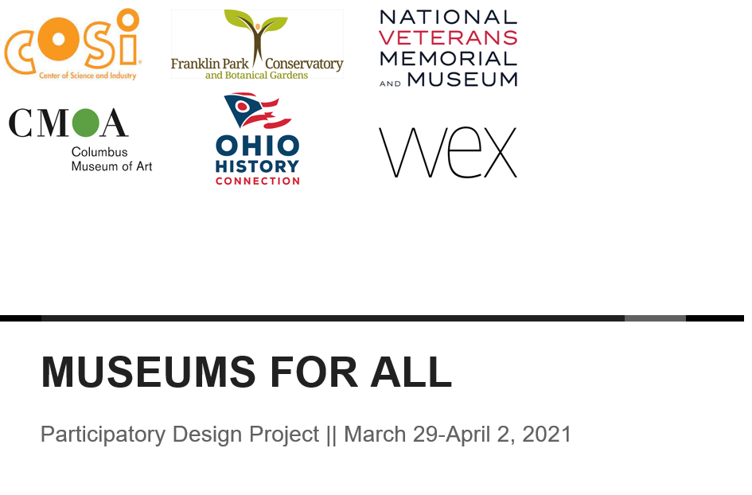
Community engagement is a long-term investment in relationship building and consistently showing up
HMW move from transactional to relational?
Museums need to have values propositions that matter to the residents they are trying to reach
Residents experiencing poverty are acutely aware of belonging cues and are constantly assessing whether something is or is not for them
People want dignity, agency and choice about how they spend their time; “free” doesn’t mean there are not costs
Curation signals intent and has consequences for how people perceive a place
When Museums for All Isn’t Working

Slide 15
When Museums for All Isn’t Working

Slide 16
When Museums for All Isn’t Working

Slide 17
Ohio History Connection’s Spark Membership
Museums for All innovation
Maintaining the principles of the daily access pass.
Evolving from a transactional interaction towards a relationship with community members.
“Selling a relationship, not a membership.”
Targeted-neighborhood approach
Applying $3 max per-ticket price, but for a year-long family membership.
Integrated with Near-Neighbor work in Linden community, leveraging greater alignment with mission and overall sustainability of approach.

Slide 18
Ohio History Connection’s Spark Membership
Memberships create natural opportunity for connection,
collaboration, and sense of togetherness.
Memberships versus one-time visit engagement enables:
Trust building and disrupted power balance.
Developing sense of ownership and familiarity with visitation experience.
Facilitating two-way versus one-sided exchange.
Access to feedback regarding sense of welcoming and belonging.

Slide 19
Let’s Discuss: How does M4A Affect Your Museum?
Have you noticed anything different about your museum since M4A was implemented?
Does M4A impact your daily work efforts?

Slide 20
Let’s Discuss: Is Museums for All always the right idea?
What community accessibility challenges do you face?
Would SNAP enrollment address all of them?
If not, what other excluded people in your community should you consider helping with access?
How to gauge if your museum is culturally and operationally ready to implement M4A.
Negative consequences of poor implementation.

Slide 21
Questions?
Ben Anthony – banthony@ohiohistory.org
Alex Ingley – aingley@ohiohistory.org

