Slide 1
Museum Education 101 and 201
Traci Manning
Curator of Education, Mahoning Valley Historical Society

Slide 2
Mahoning Valley Historical Society
Founded 1875
Millions of archival items
Hundreds of thousands of 3D items, multiple off-site storage locations
3 locations – Arms Family Museum, Tyler History Center, Stewart Media Archives
AAM Accredited since 1977

Slide 3
MVHS Education and Outreach Programs
3 Tier Approach
Public Programs
Curriculum Programs
Family & Youth Programs
Annually, MVHS serves between 8,000 – 10,000 people with outreach programs in addition to the more than 10,000 museum visitors

Slide 4
Syllabus
Identify your story
Identify your audience
Identify type of program
Funding
Gather items, documents, and other materials
Add educational elements
Who is going to teach the program?
Practice with a test audience
Market the program
Evaluation, sustainability, and other issues

Slide 5
What Is Museum Education?
“Museum education is the field of study that focuses on teaching in and through museums. Museum educators work to support the educational mission of museums by creating opportunities for people to learn from the collections and exhibitions. Museum education also encompasses the study of how museums can be more effective in meeting the needs of their audiences. Museum education programs can take many different forms, but all share the goal of using the museum as a resource for learning. Museum educators may design programs for school groups, families, adults, or any other type of museum visitor. Programs can be offered on-site at the museum or off-site at schools or community centers. Museum education may also take the form of research or professional development for museum staff.”

Slide 6
101: Identify Your Story
What’s your message?
Your mission?
How do you want to convey that message?

Slide 7
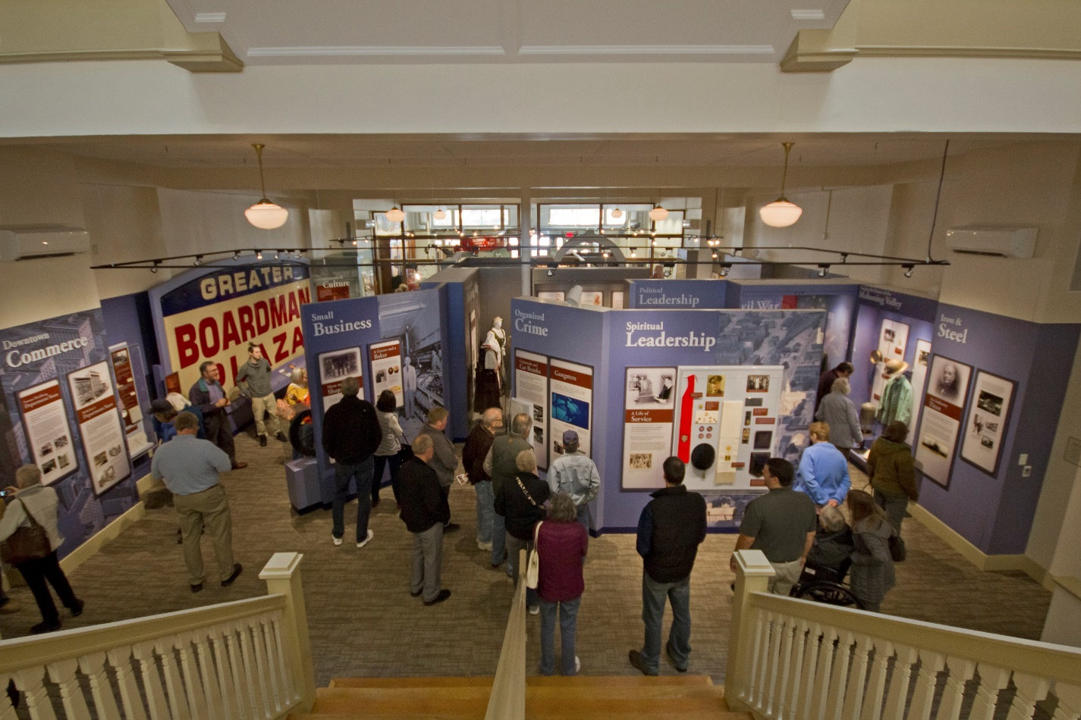
201: What is your story? Whose voice is telling it?
Notes:
Think about your mission and find the story that you want to tell.
You might have one story or you might have 1,000 stories
Leverage your collection and find what speaks to you
You will probably only ever teach an inch of that story – but you need to know it a mile deep
Students will come at you with questions you’ve likely never thought of and you need to be prepared to answer those questions

Slide 8
Think Deeper
Pioneer stories
School books and slates
Old dead rich white guys
Yes, those are important elements of history,
but what other stories can you tell?
Whose voices are missing?
What story might connect a student with the past?

Slide 9
101: Identify Your Audience
Schools, community groups, afterschool programs
The general public, museum visitors
In person, virtual & live, online, TV, newspapers, radio…

Slide 10
101: Identify Type of Program
Walking tour
Lecture
Panel discussion
Hands-on pop up
Food based program
Blog, written story
Video, interview
TV segment
Newspaper article
Social media posts
Museum tours
Museum exhibits
(remember, those are part of museum education, too!!)
Museum education comes in many shapes and styles
School program
Interactive
Lecture
Combination?

Slide 11
Diving Into School Programs
Field Trips are on the decline
Funding busses, substitutes…
How do we bring our stories, our collections to students if they don’t come to us?
Outreach!
Let’s build a school program!

Slide 12
In-Person Programs – The Three Is
Immersive
Role playing
First person narratives
Games
Journalist activities
Debates
Be careful not to go too far!
Notes:
Immersive
Role playing can be a great way to learn about life in the past – students can do this through a game, portray a news reporter and interview someone, write a diary from a first-person perspective
Role playing can also go too far
Students should never be forced to portray someone
– never ask a student to portray a marginalized or minoritized person for the sake of a lesson, no student should ever have to pretend to pick cotton – or buy and sell another student

Slide 13
Interactive
Can students handle artifacts?
Copies of primary sources?
Reproduction artifacts?
Can students ask questions?
Prepare to present an inch of the story – but know a mile!
It is really hard to be Immersive and Interactive with large groups – all MVHS programs are taught one classroom at a time, not in a large auditorium
Notes:
Interactive
Can students handle artifacts?
Copies of primary sources?
Reproduction artifacts?
Can students ask questions?
You might think this is silly… but it’s not.
This is where the presenter needs to have a solid foundation of knowledge.

Slide 14
Interesting!
Notes:
Let’s face it, if your presenter isn’t interested in the material, the students aren’t going to be interested
It might your 748th time presenting this program, but it’s probably their first time participating… be worthy of that!

Slide 15
101: Funding
Local grants, local foundations
Prepare a budget for items, marketing, mailings, mileage, staff time (if needed)
Break down what a single program costs and how many programs are feasible
What items can be used multiple times
Things to think about
Mileage to and from the school/site
Replacing broken items
Copies of worksheets or other materials

Slide 16
101: Add Education Elements
If your program is for school students, it is important to make sure you are aligning your program to curriculum standards
They aren’t as immense as they appear

Slide 17
Ohio Social Studies Standards
STRAND DEFINITIONS FOR OHIO’S LEARNING STANDARDS FOR SOCIAL STUDIES STANDARDS, K-8
HISTORY
Students use materials drawn from the diversity of human experience to analyze and interpret significant events, patterns and themes in the history of Ohio, the United States and the world.

Slide 18
HISTORY
Historical Thinking and Skills
Historical thinking begins with a clear sense of time – past, present and future – and becomes more precise as students progress. Historical thinking includes skills such as locating, researching, analyzing and interpreting primary and secondary sources so that students can begin to understand the relationships among events and draw conclusions.

Slide 19
K: A Child’s Place in Time and Space
The kindergarten year is the time for children to begin to form concepts about the world beyond their own classroom and communities. Culture, heritage and democratic principles are explored, building upon the foundation of the classroom experience. Children deepen their learning about themselves and begin to form an understanding of roles, responsibility for actions and decision-making in the context of the group setting
1st: Families Now and Long Ago, Near and Far
The first-grade year builds on the concepts developed in kindergarten by focusing on the individual as a member of a family. Students begin to understand how families lived long ago and how they live in other cultures. They develop concepts about how the world is organized spatially through beginning map skills. They build the foundation for understanding principles of government and their roles as citizens.
2nd: People Working Together
Work serves as an organizing theme for the second grade. Students learn about jobs today and long ago. They use biographies, primary sources and artifacts as clues to the past. They deepen their knowledge of diverse cultures and their roles as citizens.

Slide 20
3rd Communities: Past and Present, Near and Far
The local community serves as the focal point for third grade as students begin to understand how their communities have changed over time and to make comparisons with communities in other places. The study of local history comes alive through the use of artifacts and documents. They also learn how communities are governed and how the local economy is organized.
4th Ohio in the United States
The fourth-grade year focuses on the early development of Ohio and the United States. Students learn about the history, geography, government and economy of their state and nation. Foundations of U.S. history are laid as students study prehistoric Ohio cultures, early American life, the U.S. Constitution, and the development and growth of Ohio and the United States. Students begin to understand how ideas and events from the past have shaped Ohio and the United States today.
5th Regions and People of the Western Hemisphere
In grade five, students study the Western Hemisphere (North and South America), its geographic features, early history, cultural development and economic change. Students learn about the early inhabitants of the Americas and the impact of European exploration and colonization. The geographic focus includes the study of contemporary regional characteristics, the movement of people, products and ideas, and cultural diversity. Students develop their understanding of the relationship between markets and available resources.

Slide 21
6th Regions and People of the Eastern Hemisphere
In grade six, students study the Eastern Hemisphere (Africa, Asia, Australia and Europe), its geographic features, early history, cultural development and economic change. Students learn about the development of river civilizations in Africa and Asia, including their governments, cultures and economic systems. The geographic focus includes the study of contemporary regional characteristics, the movement of people, products and ideas, and cultural diversity. Students develop their understanding of the role of consumers and the interaction of markets, resources and competition.
7th World Studies from 750 B.C. to 1600 A.D.: Ancient Greece to the First Global Age
In seventh grade, an integrated study of world history is presented, beginning with ancient Greece and continuing through global exploration. All four social studies strands are used to illustrate how historic events are shaped by geographic, social, cultural, economic and political factors. Students develop their understanding of how ideas and events from the past have shaped the world today.
8th U.S. Studies from 1492 to 1877: Exploration through Reconstruction
The historical focus continues in the eighth grade with the study of European exploration and the early years of the United States. This study incorporates all four social studies strands into a chronologic view of the development of the United States. Students examine how historic events are shaped by geographic, social, cultural, economic and political factors.

Slide 22
High School Standards
AMERICAN HISTORY
This course examines the history of the United States of America from 1877 to the present. The federal republic has withstood challenges to its national security and expanded the rights and roles of its citizens. The episodes of its past have shaped the nature of the country today and prepared it to attend to the challenges of tomorrow. Understanding how these events came to pass and their meaning for today’s citizens is the purpose of this course. The concepts of historical thinking introduced in earlier grades continue to build with students locating and analyzing primary and secondary sources from multiple perspectives to draw conclusions.

Slide 25
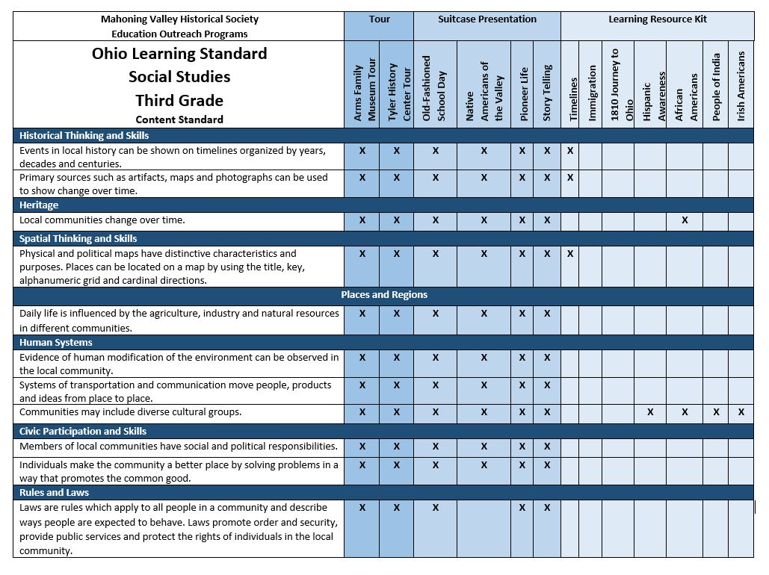

Slide 26
Now What?
Once you have an idea of where your story fits into the standards, how do you craft a program?
Lay out learning objectives based on those standards – they are broad for a reason
Determine goals

Slide 27
101: Put it all together
Think about a sequence and outline instead of a script
Two programs are never going to be the same!
You might talk about the same topics every time, but likely not in exactly the same way
Your program might be an introduction, a review, or maybe the only time that topic gets covered
Opening, narrative, interactive stations… what is the best way to tell the story?
Have a set time in mind, but know that some schools have to fit programs into a full schedule that cannot change, so be adaptable.
45 – 60 minutes is a good range for 2nd grade and older
20 – 30 minutes for PreK – 1st grade

Slide 28
101: Gather Items
If the program is interactive, it is important to ensure that your items are durable.
3D Materials
It’s best to use reproduction items if you are worried about the item’s safety.
2D Materials
High resolution copies in plastic sleeves with captions or highlighted info (especially if it is a longer document)

Slide 29
201 – Sourcing Items
Avoid antique shops
Go for more authentic reproduction items
Beware of taking artifacts into a classroom unless they will be very protected
Instead, use high resolution copies of documents, images, maps – and reproduction artifacts instead of the real thing
Search through living history sites to find high-quality sources for just about any era
Think about durability
Think about what each items adds to the program
Think about size and transportability

Slide 30
201: Varying the Style
Primary source based programs
Small groups with copies of primary sources and a guided worksheet
Journey Through Local Industry
Underground Railroad
Civil War Exploration

Slide 31
101: Who is going to teach the program?
“It’s easier to teach a teacher history than to teach a historian how to teach.”
Be engaged, be lively, be approachable, be interested, be prepared
BCI/FBI Background checks

Slide 32
201: Share an inch, know a mile
The deeper we dive into history, the more you need to know
You may never pull from that knowledge, but be prepared anyway

Slide 33
Bonus Points: Diving Really Deep
History education is under attack and museums have a very important role to play in making sure history is taught in its most complete, inclusive, and critical manner.

Slide 34
High school seniors struggle on even the most basic questions about American enslavement of Africans.
Only 8% of high school seniors surveyed can identify slavery as the central cause of the Civil War.
Two-thirds (68%) don’t know that it took a constitutional amendment to formally end slavery.
Fewer than 1 in 4 students (22%) can correctly identify how provisions in the Constitution gave advantages to slaveholders.
Notes:
Unfortunately, research conducted by the Southern Poverty Law Center in 2017 shows that our schools are failing to teach the hard history of African enslavement. We surveyed U.S. high school seniors and social studies teachers, analyzed a selection of state content standards, and reviewed 10 popular U.S. history textbooks.
The research indicates that
Teachers are serious about teaching slavery, but there’s a lack of deep coverage of the subject in the classroom.
Although teachers overwhelmingly (over 90%) claim they feel “comfortable” discussing slavery in their classrooms, their responses to open-ended questions reveal profound unease around the topic.
58% of teachers find their textbooks inadequate.
States fail to set appropriately high expectations with their content standards. In a word, the standards are timid.
Of the 15 sets of state standards we analyzed, none addresses how the ideology of white supremacy rose to justify the institution of slavery; most fail to lay out meaningful requirements for learning about slavery, about the lives of the millions of enslaved people, or about how their labor was essential to the American economy.
40% of teachers believe their state offers insufficient support for teaching about slavery.

Slide 35
We teach about slavery without context, preferring to present the good news before the bad.
In elementary school, students learn about the Underground Railroad, about Harriet Tubman or other “feel good” stories, often before they learn about slavery.
In high school, there’s overemphasis on Frederick Douglass, abolitionists and the Emancipation Proclamation and little understanding of how slave labor built the nation.
Notes:
Looking behind the statistics, we see seven key problems with current practices.
1. We teach about slavery without context, preferring to present the good news before the bad. In elementary school, students learn about the Underground Railroad, about Harriet Tubman or other “feel good” stories, often before they learn about slavery. In high school, there’s overemphasis on Frederick Douglass, abolitionists and the Emancipation Proclamation and little understanding of how slave labor built the nation.
2. We tend to subscribe to a progressive view of American history that can acknowledge flaws only to the extent that they have been addressed and solved. Our vision of growing ever “more perfect” stands in the way of our need to face the continuing legacy of the past.
3. We teach about the American enslavement of Africans as an exclusively southern institution. While it is true that slavery reached its apex in the South during the years before the Civil War, it is also true that slavery existed in all colonies, and in all states when the Declaration of Independence was signed, and that it continued to be interwoven with the economic fate of the nation long into the 19th century.
4. We rarely connect slavery to the ideology that grew up to sustain and protect it: white supremacy. Slavery required white supremacy to persist. In fact, the American ideology of white supremacy, along with accompanying racist dogma, developed precisely to justify the perpetuation of slavery.
5. We often rely on pedagogy poorly suited to the topic. When we asked teachers to tell us about their favorite lesson when teaching about slavery, dozens proudly reported classroom simulations. Simulation of traumatic experiences is not shown to be effective as a learning strategy and can harm vulnerable children.
6. We rarely make connections to the present. How can students develop a meaningful understanding of the rest of American history if they do not understand the scope and lasting impact of enslavement? Reconstruction, the Great Migration, the Harlem Renaissance and the civil rights movement do not make sense when so divorced from the arc of American history.
7. We tend to center on the white experience when we teach about slavery. Too often, the varied, lived experience of enslaved people is neglected while educators focus on the broader political and economic impacts of slavery. Politically and socially, we focus on what white people were doing in the time leading up to the Civil War.

Slide 36
101: Practice With a Test Audience
Reach out to a teacher or group who might be interested in being a “test” audience.
This is a great way to test timing, effectiveness, and the overall reception of the program.

Slide 37
101: Market The Program
Perhaps the most difficult aspect of creating outreach programs
Top – down?
Bottom – up?
How do you find teachers?
Can a local ECS help?
Seek help from other organizations or institutions
What is your capacity?
Be honest with yourself!
Don’t email 500 teachers if you can only lead 20 programs a year
Last year, we taught 387 1-hour long programs and 94 30-minute programs
And still had a waitlist of more than 45 requests for an additional 250 hours of programming!

Slide 38
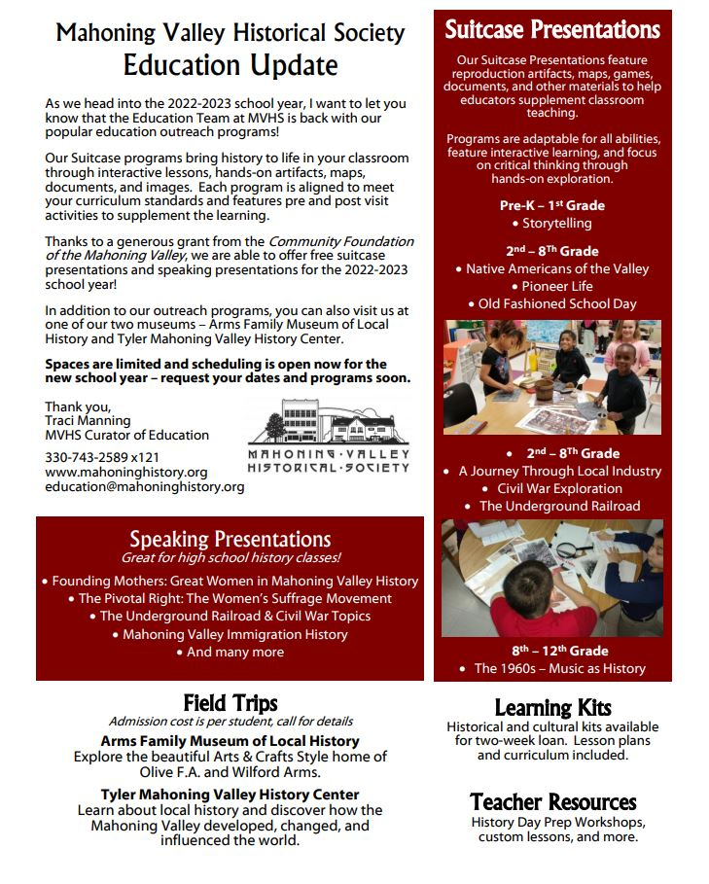
Each year, an Update flyer is sent to more than 2,000 local teachers in public, private, and parochial schools
Emails are pulled from school websites and published directories
(that takes about 10 hours each year to update)
My rule of thumb:
All administrators, principals, admin assistants - matter their grave level
Every elementary teacher, and any social studies teachers in middle/high school

Slide 39
101: Scheduling
Things to think about:
What do you need to know?
School, location, grade, teacher, schedule, how many students
If one classroom at a time, can you get all of them in on one day?
What do the teachers need to know?
Setup needs, any equipment?
What is easiest for you?
Phone, email, fax?
Program confirmations

Slide 41
101: Evaluation, Sustainability
Evaluate the program
Does it work?
Does the audience enjoy it?
Do the teachers or group leaders find it effective in teaching the main objective?
Does it translate your story, message, or mission in a clear way?
Sustain the program
How long can it last?
Are you able to replace items if they are broken?
Do you have a craft project or other element that will need to be replenished?
Are you financially able to keep the program going?

Slide 42
201: Pre & Post Visit Activities – Evaluation
Pre and Post Visit Activities
Vocabulary
Reading
Writing
How can we great from remembering and understanding to analyzing and creating?
Evaluation
Teachers
School Administrators
Students
Museum Staff/Board
Notes:
Supply them with everything they need… whether its an online survey… or a paper form – if paper, given them a self addressed, stamped envelope – make it as easy as possible
Teachers
Written evaluations with data points
Open ended questions for feedback
Supply them with everything they need to do it
School admins
It can be a challenge to track program impact over time, especially with a one and done program – perhaps invite school admins to join in the program to see how it goes
Students
Gauge interest throughout the program
Track the questions asked
Are there common questions? Consider adapting the program to include that information
Ask them what they liked and what they would change

Slide 43
Sustain, Expand, Be Proud!
Can we spark curiosity?
Can we promote research?
Can we encourage museum and historic site visits?
Can we inspire?
Can we mentor?
Can we spur discourse and discussion?
Can we foster critical thinking?

