Slide 1
Food & Beverage Service
How to Incorporate into Events, Programming, Fundraisers, and More!

Slide 2
Agenda
Food Service
Alcohol Service
Best Practices
Questions

Slide 3
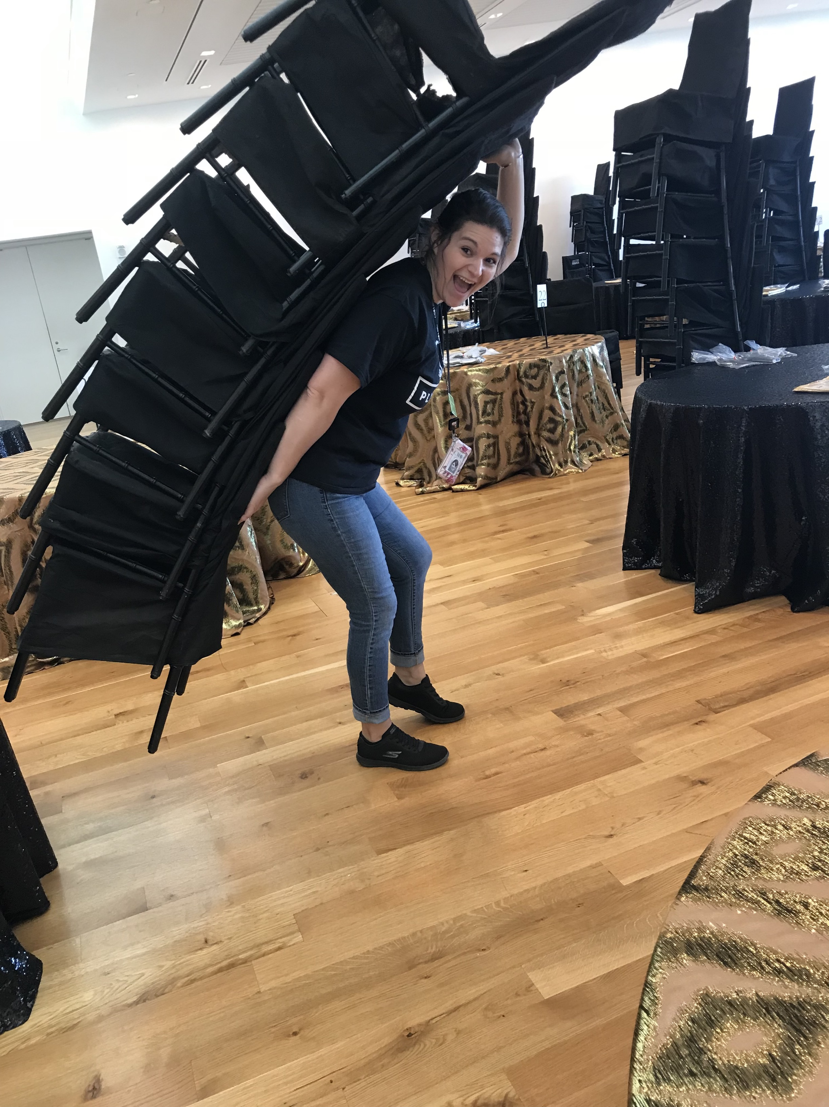
Who Am I?
Kristal Bell
Director of Business Development
Ohio History Connection, Columbus
Notables:
Ohio History Connection, April 2021 – Present
Director of Business Development
Columbus Museum of Art, May 2014 – Sept 2019
Director of Special Events Operations and Catering
Java Jo’s, 2005-2009
Barista

Slide 4
A little about you
Who works at a public space?
Who works with visitor groups or volunteers?
Who has ever thought to yourself, “Man, that potato salad has been sitting on the picnic table for far too long?”
Who here is ready to learn about BUGS?!?

Slide 5
Food Service – The quick and icky
...what’s the big deal??
Every Year:
48 million OR 1-in-6 people will get sick from a foodborne illness*
128,000 people are hospitalized
3,000 people die

Slide 6
Food Safety – Prep Rule of Thumb
Wash hands, surfaces, and tools with warm water and soap.
Don’t mix raw meat and ready-to-eat foods.
Heat foods to the right temperatures.
Keep hot food hot and cold food cold.

Slide 7
Food Safety – it’s more than the recipe

Slide 8
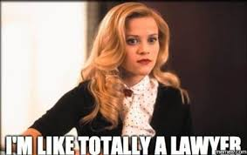
Food Service - Legally
What are we worried about?
Food safety and foodborne illness, allergies, cross-contamination
Legal liability for the protection of our guests and visitors
At-risk populations – children under 5, adults over 65,
pregnant people, people with weakened immune systems
Moral obligation to do the best you can
How do we keep people safe?
Make sure a licensed person/organization made the food
Food license/permit
Make people aware of the risks
Example: Cast Iron Scones

Slide 9
Food Service – Best Practices
Big No-No’s
Selling non-commercially made foods to guests
Inform guest if not made in a commercial kitchen
Unsafe food practices
Leaving food on display for extended periods
Outside/Sun
Temperature sensitive (40*-140*)
No tongs or serving utensils
No way to wash hands
Giving away samples of interpretive or demonstration food
Best Practices
Buy prepared foods from Grocery Stores, Caterers, Bakeries, etc
Wear gloves whenever handling the food
Use tongs and clean trays
Remember – ICE IS FOOD
EXAMPLE: Soul Cakes

Slide 10
Alcohol Service – It’s all fun and games until ...

Slide 11
Alcohol Service – Two Scenarios
SCENARIO 1
Board Member wants to have wine served at the board dinner – Venue does not have a liquor license.
Usually, BYOW – doesn’t matter where you get it
Caterer will serve OR hire bartenders for safe service
SCENARIO 2
Development wants to serve wine for the annual fundraiser on-site – You do not have a liquor license.
Two considerations – cash bar or hosted
If hosted (giving away for free), caterer can *usually* assist with procuring product and providing staff
Liability is quite high in this scenario
Product may be donated
If cash or selling drink tickets, permits are needed (next slide)
Sampling ONLY

Slide 12
Alcohol Service – Permits and Purchasing
When is a permit required?
Intent to sell by drink and/or through the use of an entrance fee/cover charge
Types of Permits
F-2, ($150): Allows non-profit orgs to sell beer, wine and spirituous liquor by the drink for no longer than four days in an area that has been voted wet through local option for beer and wine.
F-4, ($60): In conjunction with a wine distributor – Ohio Wine tasting events
F-5, ($180): Beer and intoxicating liquor issued to a riverboat at a festival sponsored by a non-profit organization
Where can I buy alcohol?
With your permit, you may purchase alcohol at any Ohio Liquor Agency and/or distributor.
Cannot use credit card to purchase. Cash or Business Check only.
It is a violation of Ohio liquor law for alcoholic beverage products to be donated to a temporary permit holder unless the donation of the product is expressly permitted by law.

Slide 13
Alcohol Service – Employee Responsibility
Service
Only paid Organization staff may service alcohol.
Includes:
Full-time or part-time staff
Contracted service staff (bartenders)
Excludes:
Volunteers and board members
Donors
Liability
Dram Shop: Establishments are liable for property damage, injuries, or deaths that occur off their property, if: The establishment knowingly sold alcohol to a person who was visibility intoxicated (e.g., staggering, bloodshot eyes, slurring, sleepy, belligerent) or underage.

Slide 14
Resources - Complicated
https://odh.ohio.gov/know-our-programs/food-safety-program/welcome-to
https://com.ohio.gov/divisions-and-programs/liquor-control/temporary-event-permits/guides-and-resources/temporary-permits-guide
https://www.servsafe.com/ServSafe-Alcohol

Slide 15
Questions

Slide 16
Based on Questions - Raffles
Raffles
The Law: https://codes.ohio.gov/ohio-revised-code/section-2915.092
Explanation: https://charitable.ohioago.gov/Charitable-Gaming
Excerpt: https://com.ohio.gov/divisions-and-programs/liquor-control/Temporary-event-permits/applications-and-forms/beer-and-intoxicating-liquor-receipts-for-fundraisers
Spirituous Liquor Receipts for Charitable Fundraisers
501(c)(3) charitable organizations or IRC Section 527 political organizations can hold a fundraiser and award beer and/or intoxicating liquor to its guests as part of a raffle, door prize, or silent auction as those terms are defined in R.C. 4301.58. If spirituous liquor is being awarded, the charity must collect and submit copies of the retail purchase receipt to us prior to the event using the form below.
Important Information You Should Know:
Make sure your raffle, silent auction, or door prize is done in accordance with Ohio law (see R.C. 4301.58(E) for details). We do not regulate gambling laws and cannot advise you on whether your event is legally compliant. You should consult your attorney, the Ohio Attorney General's Charitable Law Section, or the Ohio Department of Public Safety-Investigative Unit with questions on Ohio's gambling laws.
Beer, wine, and low-proof pre-packaged mixed beverages MUST be purchased from an Ohio liquor permit holder that has an active permit. If the above alcoholic product is donated to the organization hosting the event or if the organization purchased the product itself, the organization should have a copy of the purchase receipt showing the product was purchased from an Ohio liquor permit holder.
Spirituous liquor (high-proof over 21%) MUST be purchased from an Ohio state liquor agency. If the above alcoholic product is donated to the organization hosting the event or if the organization purchased the product itself, the organization MUST have a copy of the purchase receipt showing the product was purchased from a state liquor agency store (OHLQ location). The organization hosting the event MUST submit both a copy of the receipt and complete the fillable form below.
NO Ohio liquor permit holder or Ohio state liquor agency can donate alcoholic product to the organization for its fundraising event.

