Slide 1
Diversity Audits: A Digital Collections Case Study
Janet Rhodes
Supervisor of Digitization Services
Toledo Lucas County Public Library

Slide 2
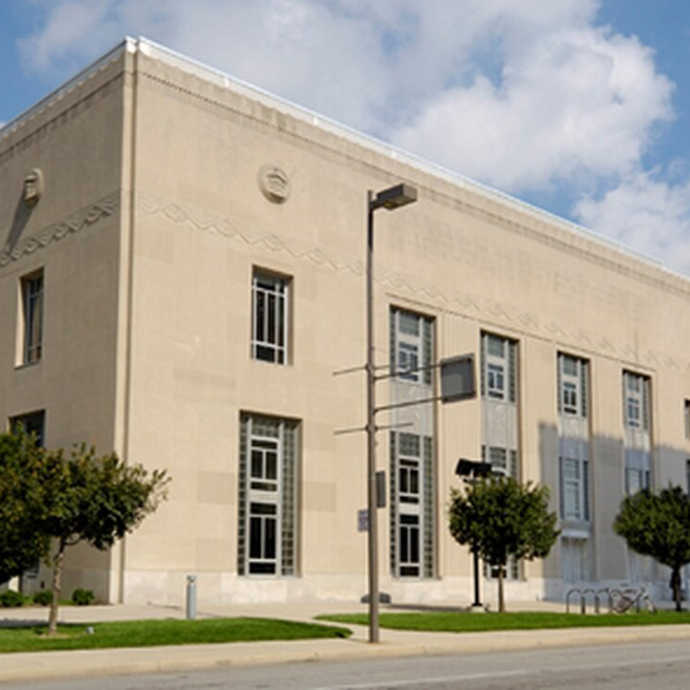
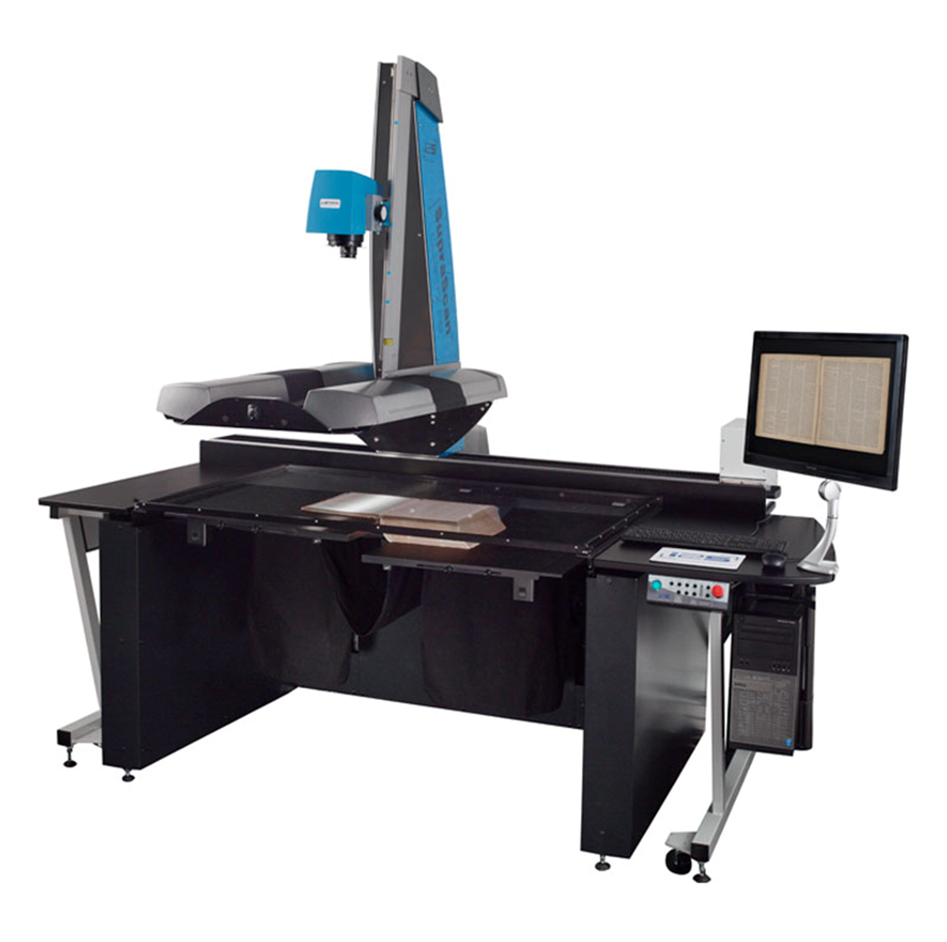
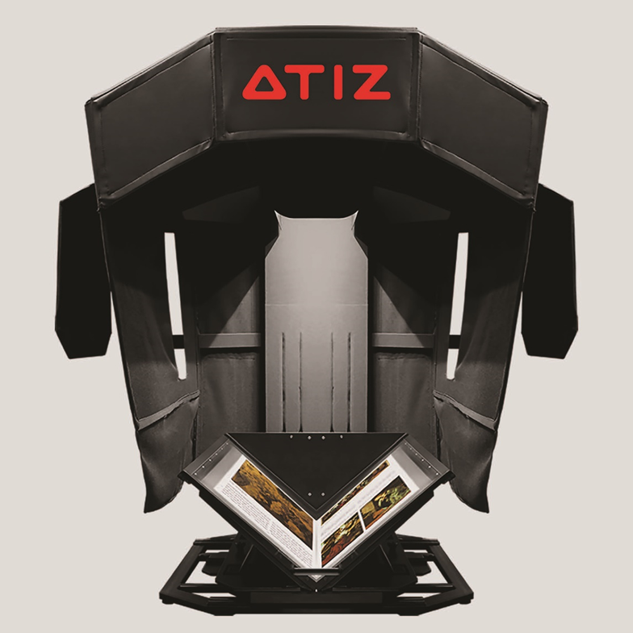
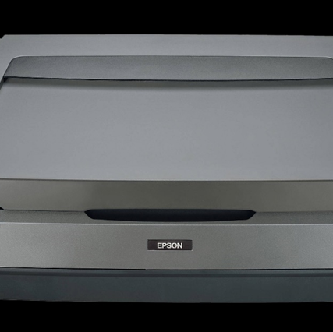
Digitization Services at TLCPL
Digitization Staff
2 full time
5 part time
Equipment
1 planetary scanner
2 book scanners
7 flatbed scanners
Digital Collections
Ohio Memory partner

Slide 3
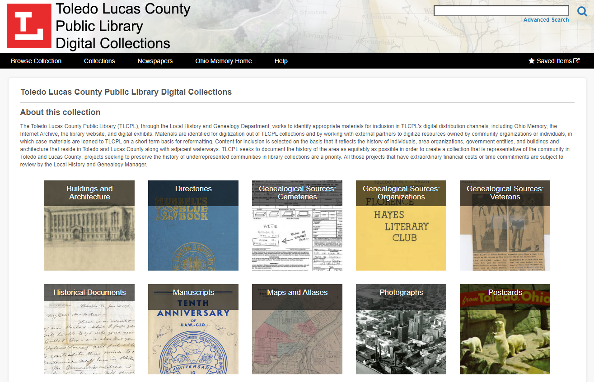

Slide 4
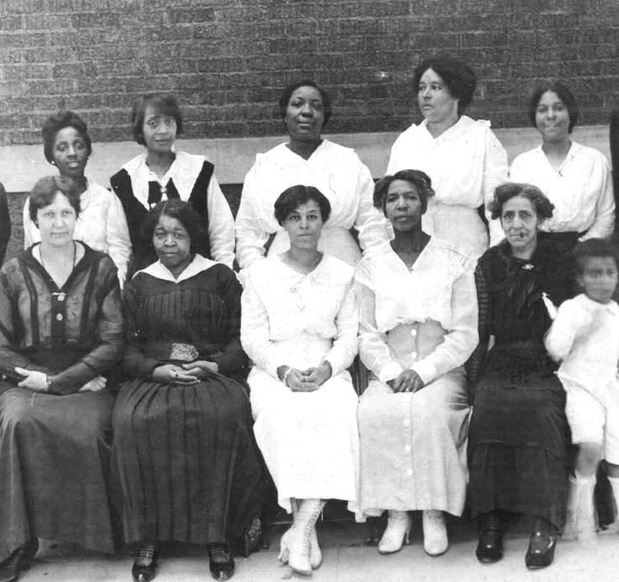
What is a Diversity Audit?
A diversity audit is an analysis of an existing collection that yields concrete data about the diversity of content within that collection.
Types of representation can include:
demographics: age, race, gender
ability, sexual orientation, religious affiliation
places and time periods
languages
material formats

Slide 5
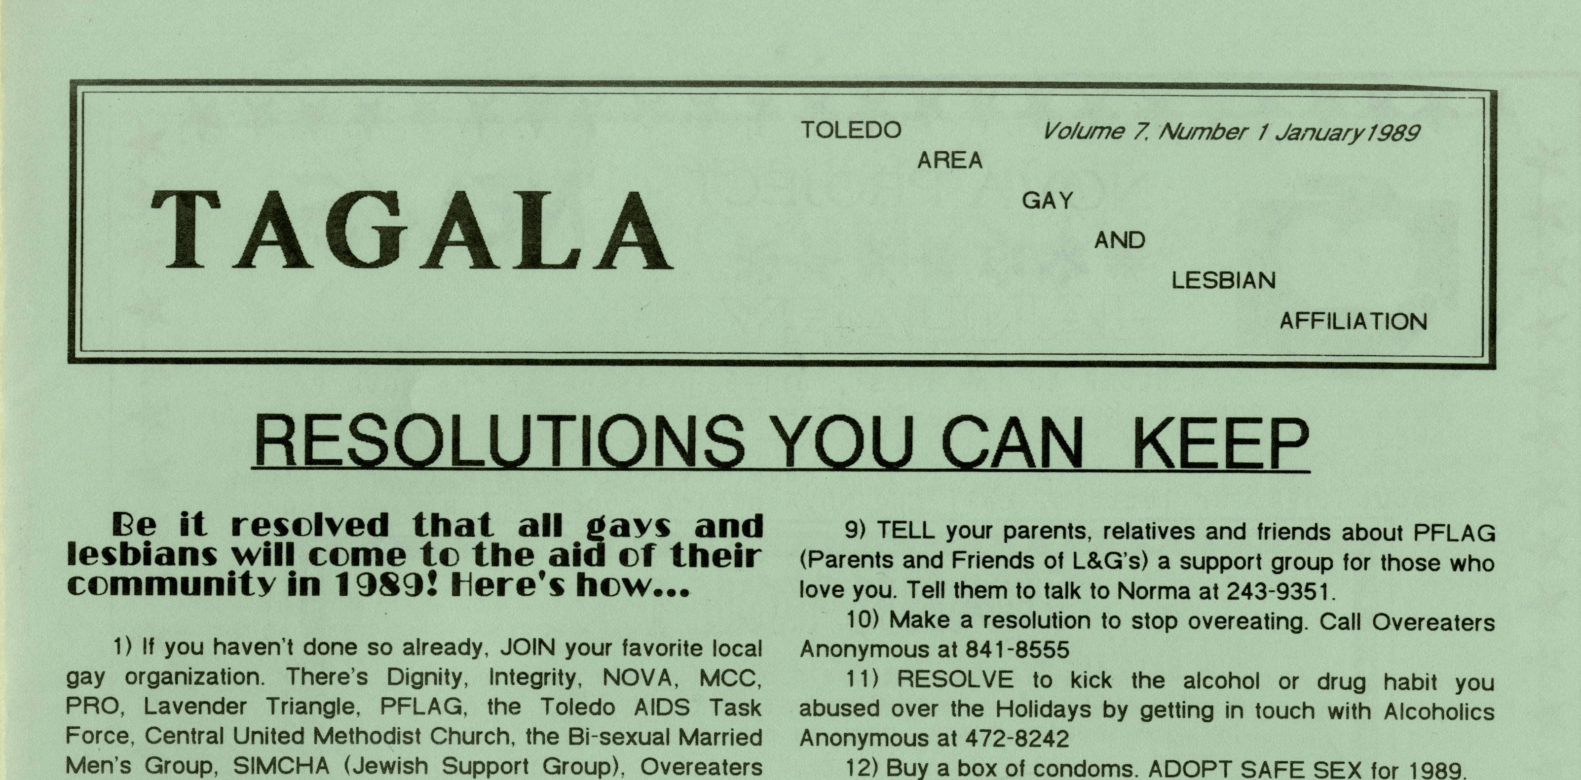
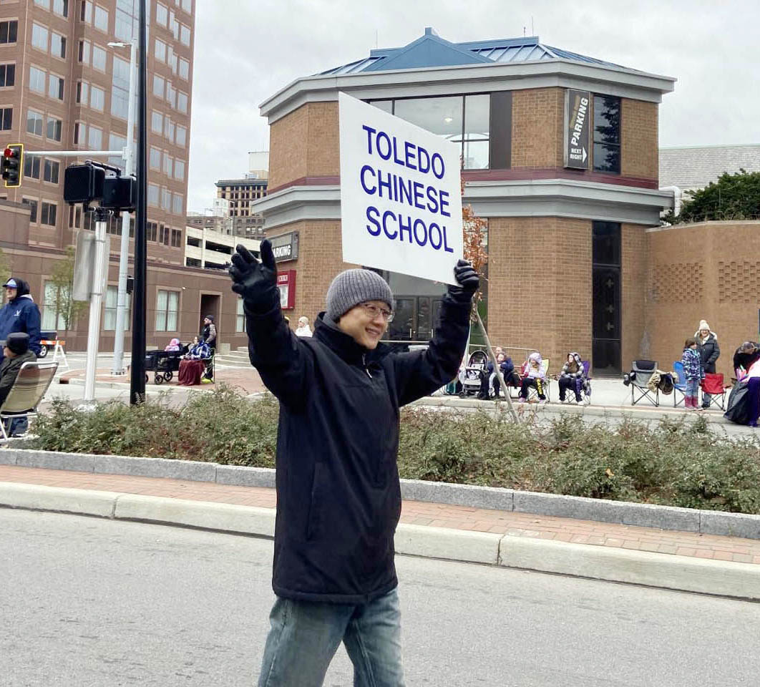
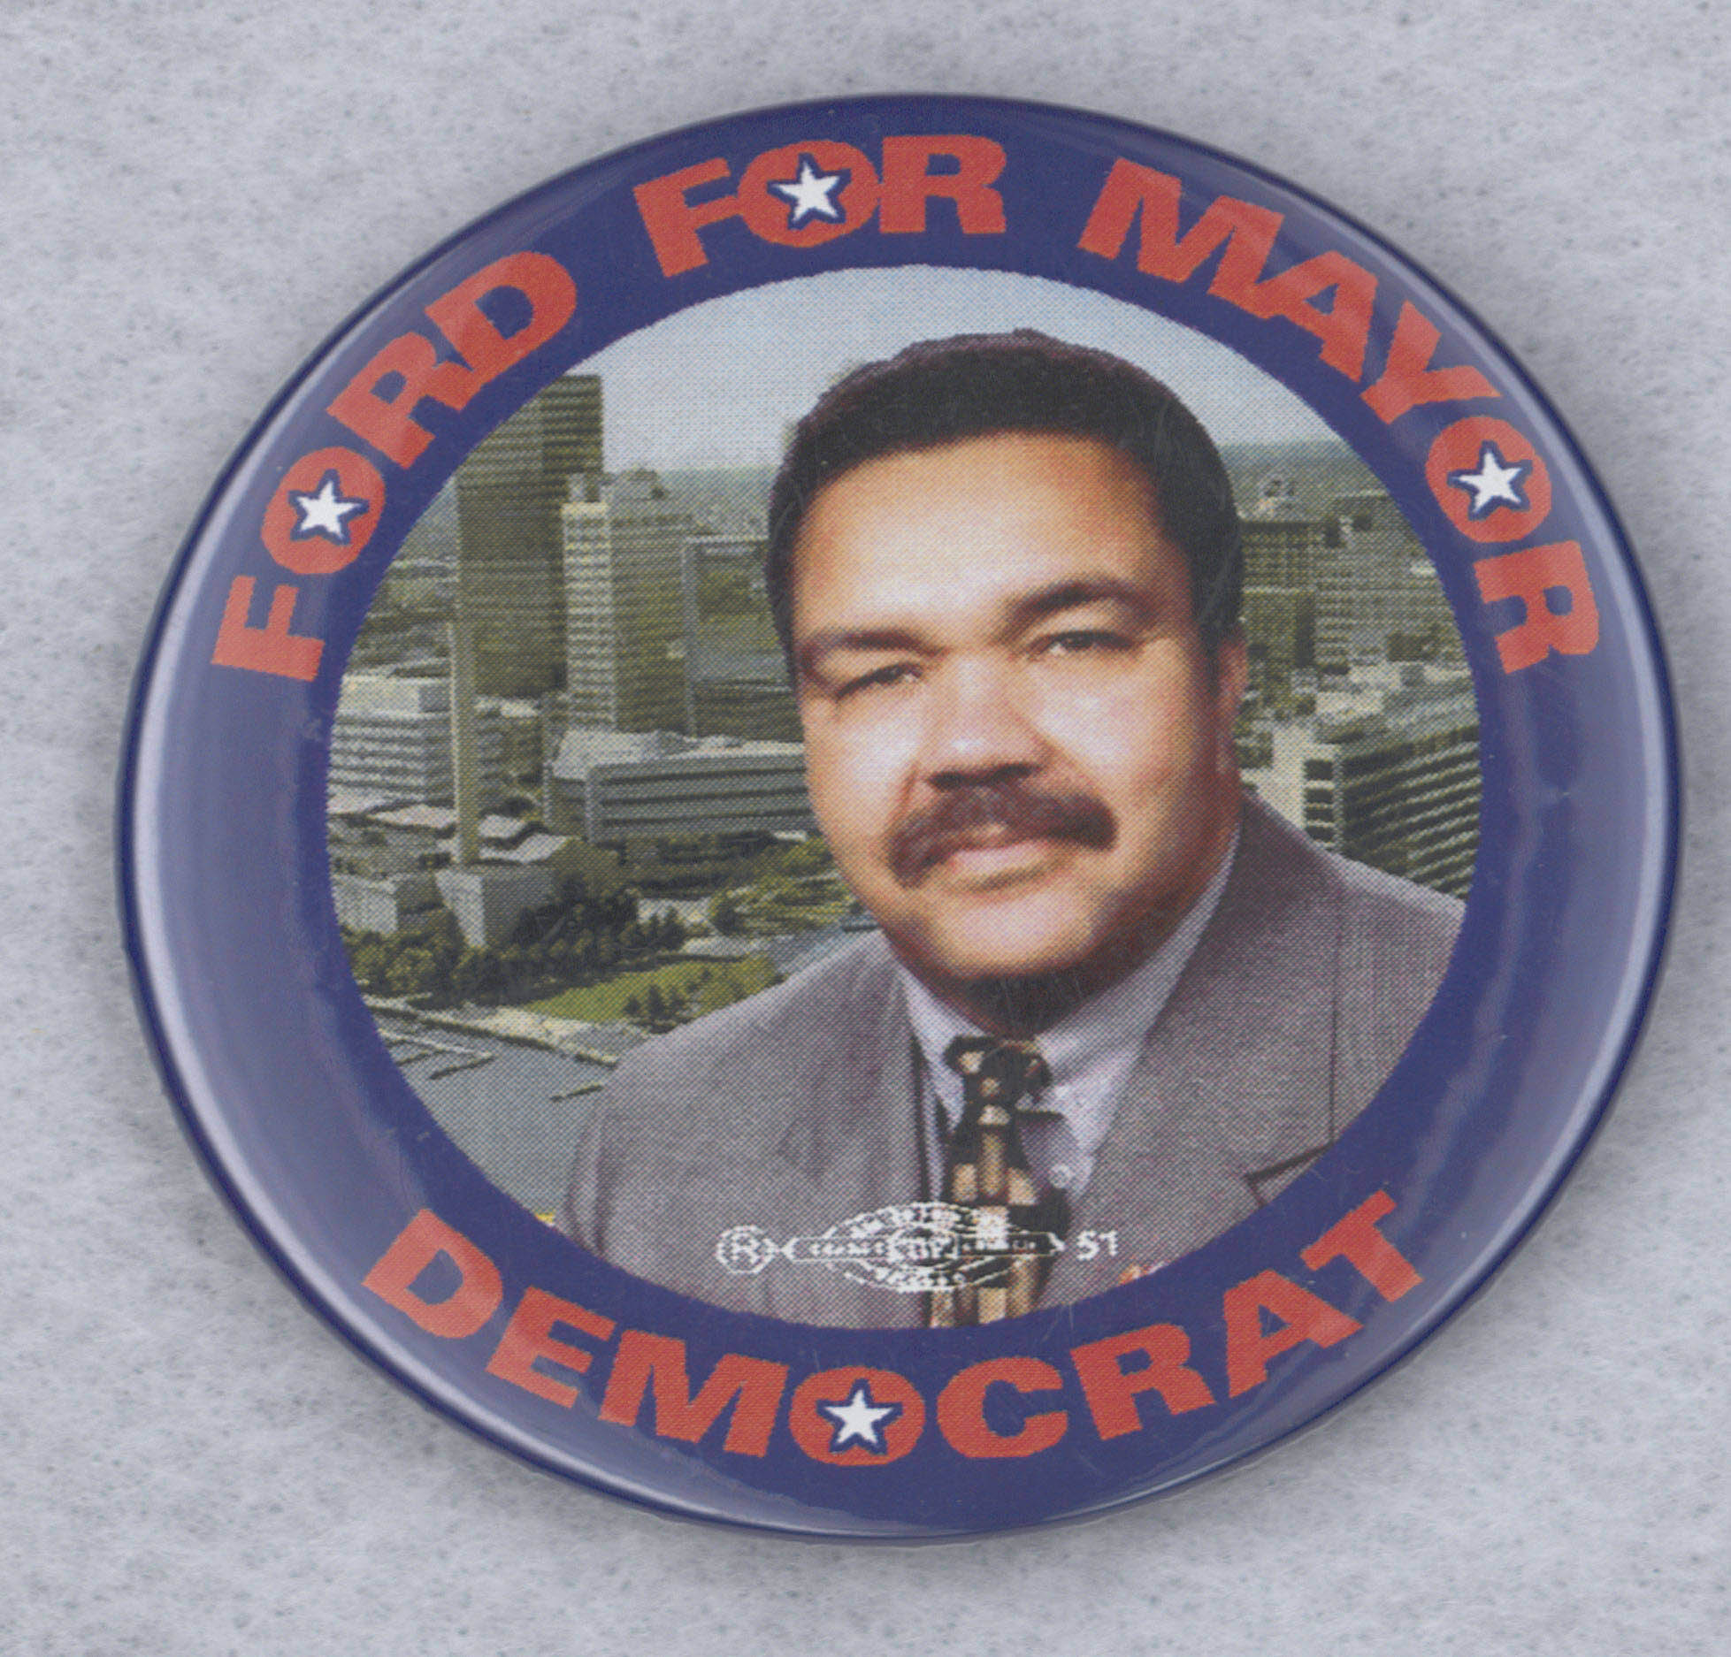
Why do a Diversity Audit?
To identify who your collection currently serves
To identify gaps in representation
To evaluate the efficacy of an existing collection development policy
To inform outreach efforts
Transparency, equity, and advocacy

Slide 6
TLCPL’s Diversity Audit
University of Michigan School of Information
Client-Based Courses and Programs
https://www.si.umich.edu/host-student-project
Project Title: Digital Collections Analysis and Strategy
Course: SI 699 Library and Archives
Students: Tere Elizalde and Gabrielle Acuña

Slide 7
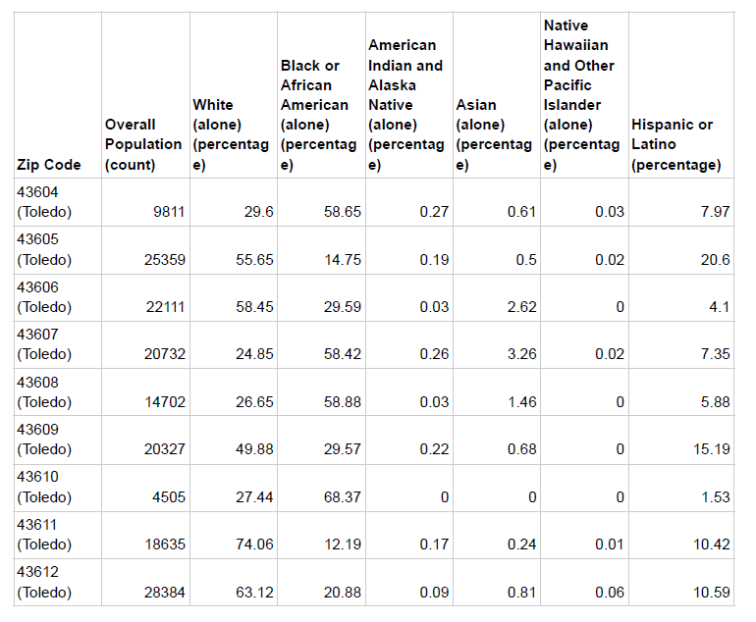
Defining Diversity in TLCPL’s Digital Collection
Considerations:
Who does TLCPL’s Digital Collections serve?
What would appropriate representation in our digital collection look like?
Demographic data gathered by the American Community Survey 2021 (5-year estimates)

Slide 8
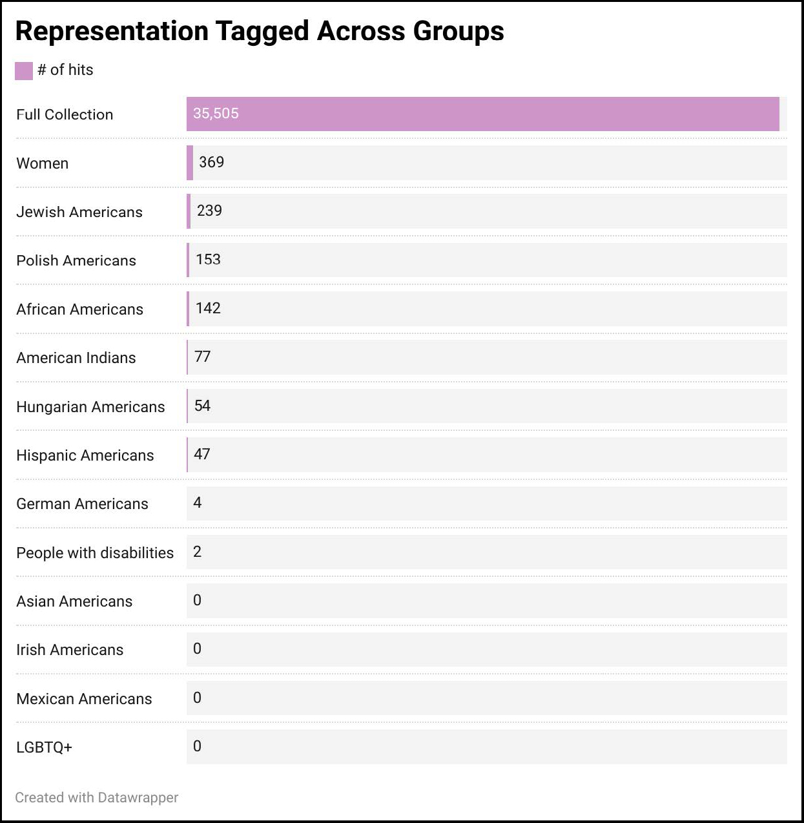
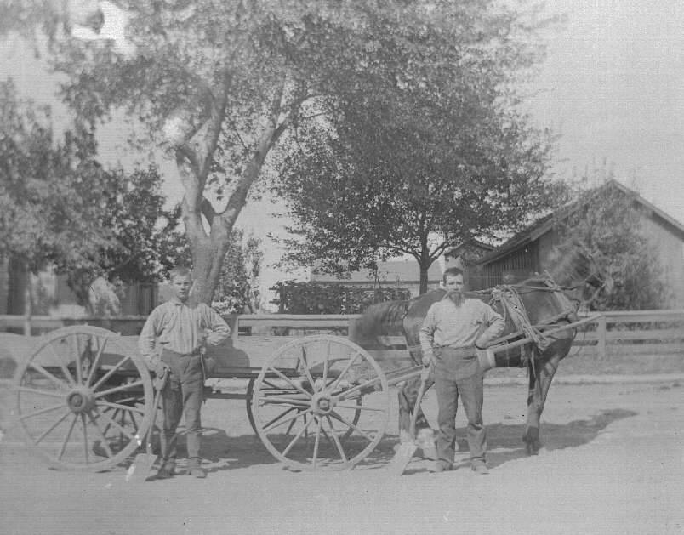
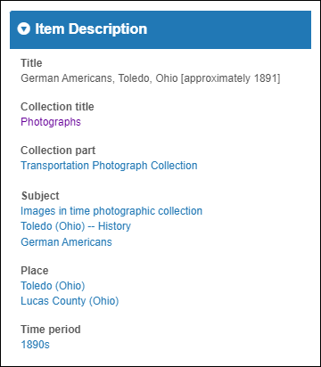
Analyzing the Digital Collection

Slide 9
Stop Digitizing

Slide 11
1. Our structure could not support our goals.

Slide 12
1. Our structure could not support our goals.
2. Our metadata needed work.

Slide 13
Next Steps after your Diversity Audit
Evaluate your resources
Don’t be afraid to ask for what you need
Advocate for the community
Make a realistic plan

Slide 14
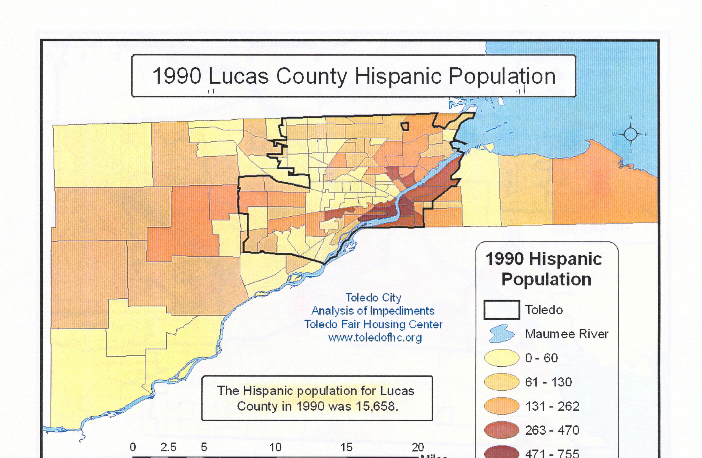
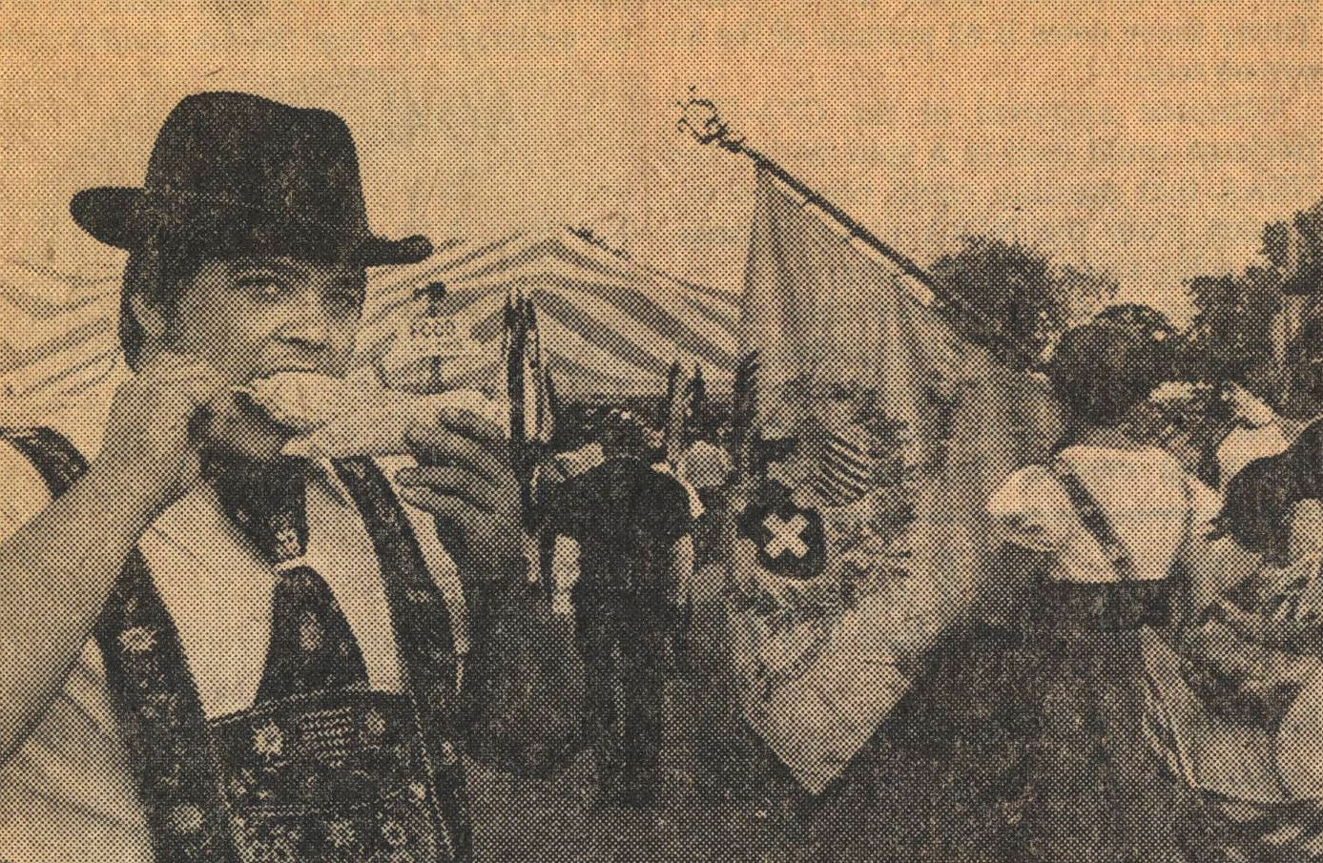
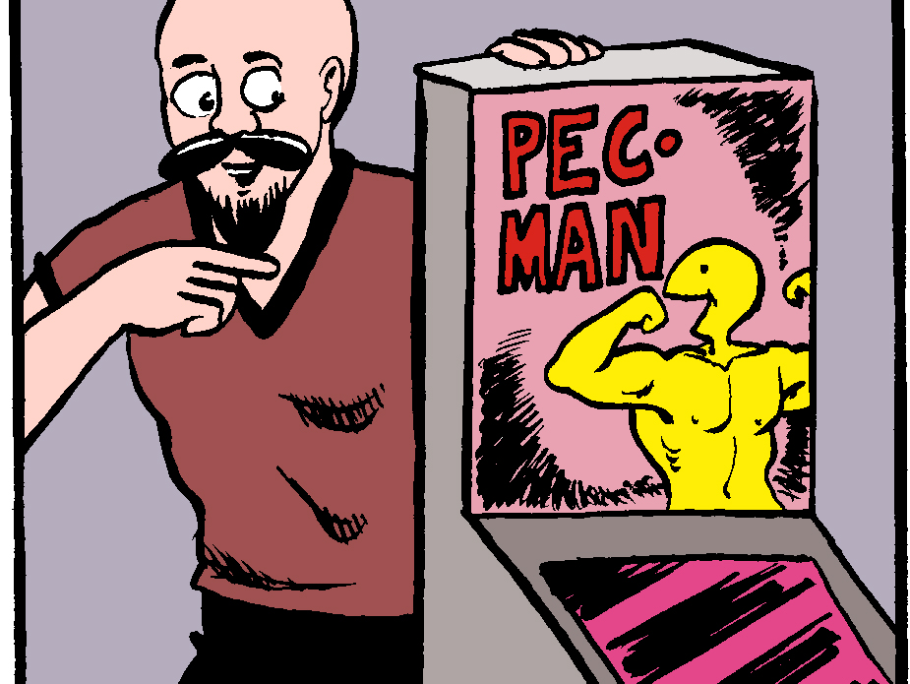
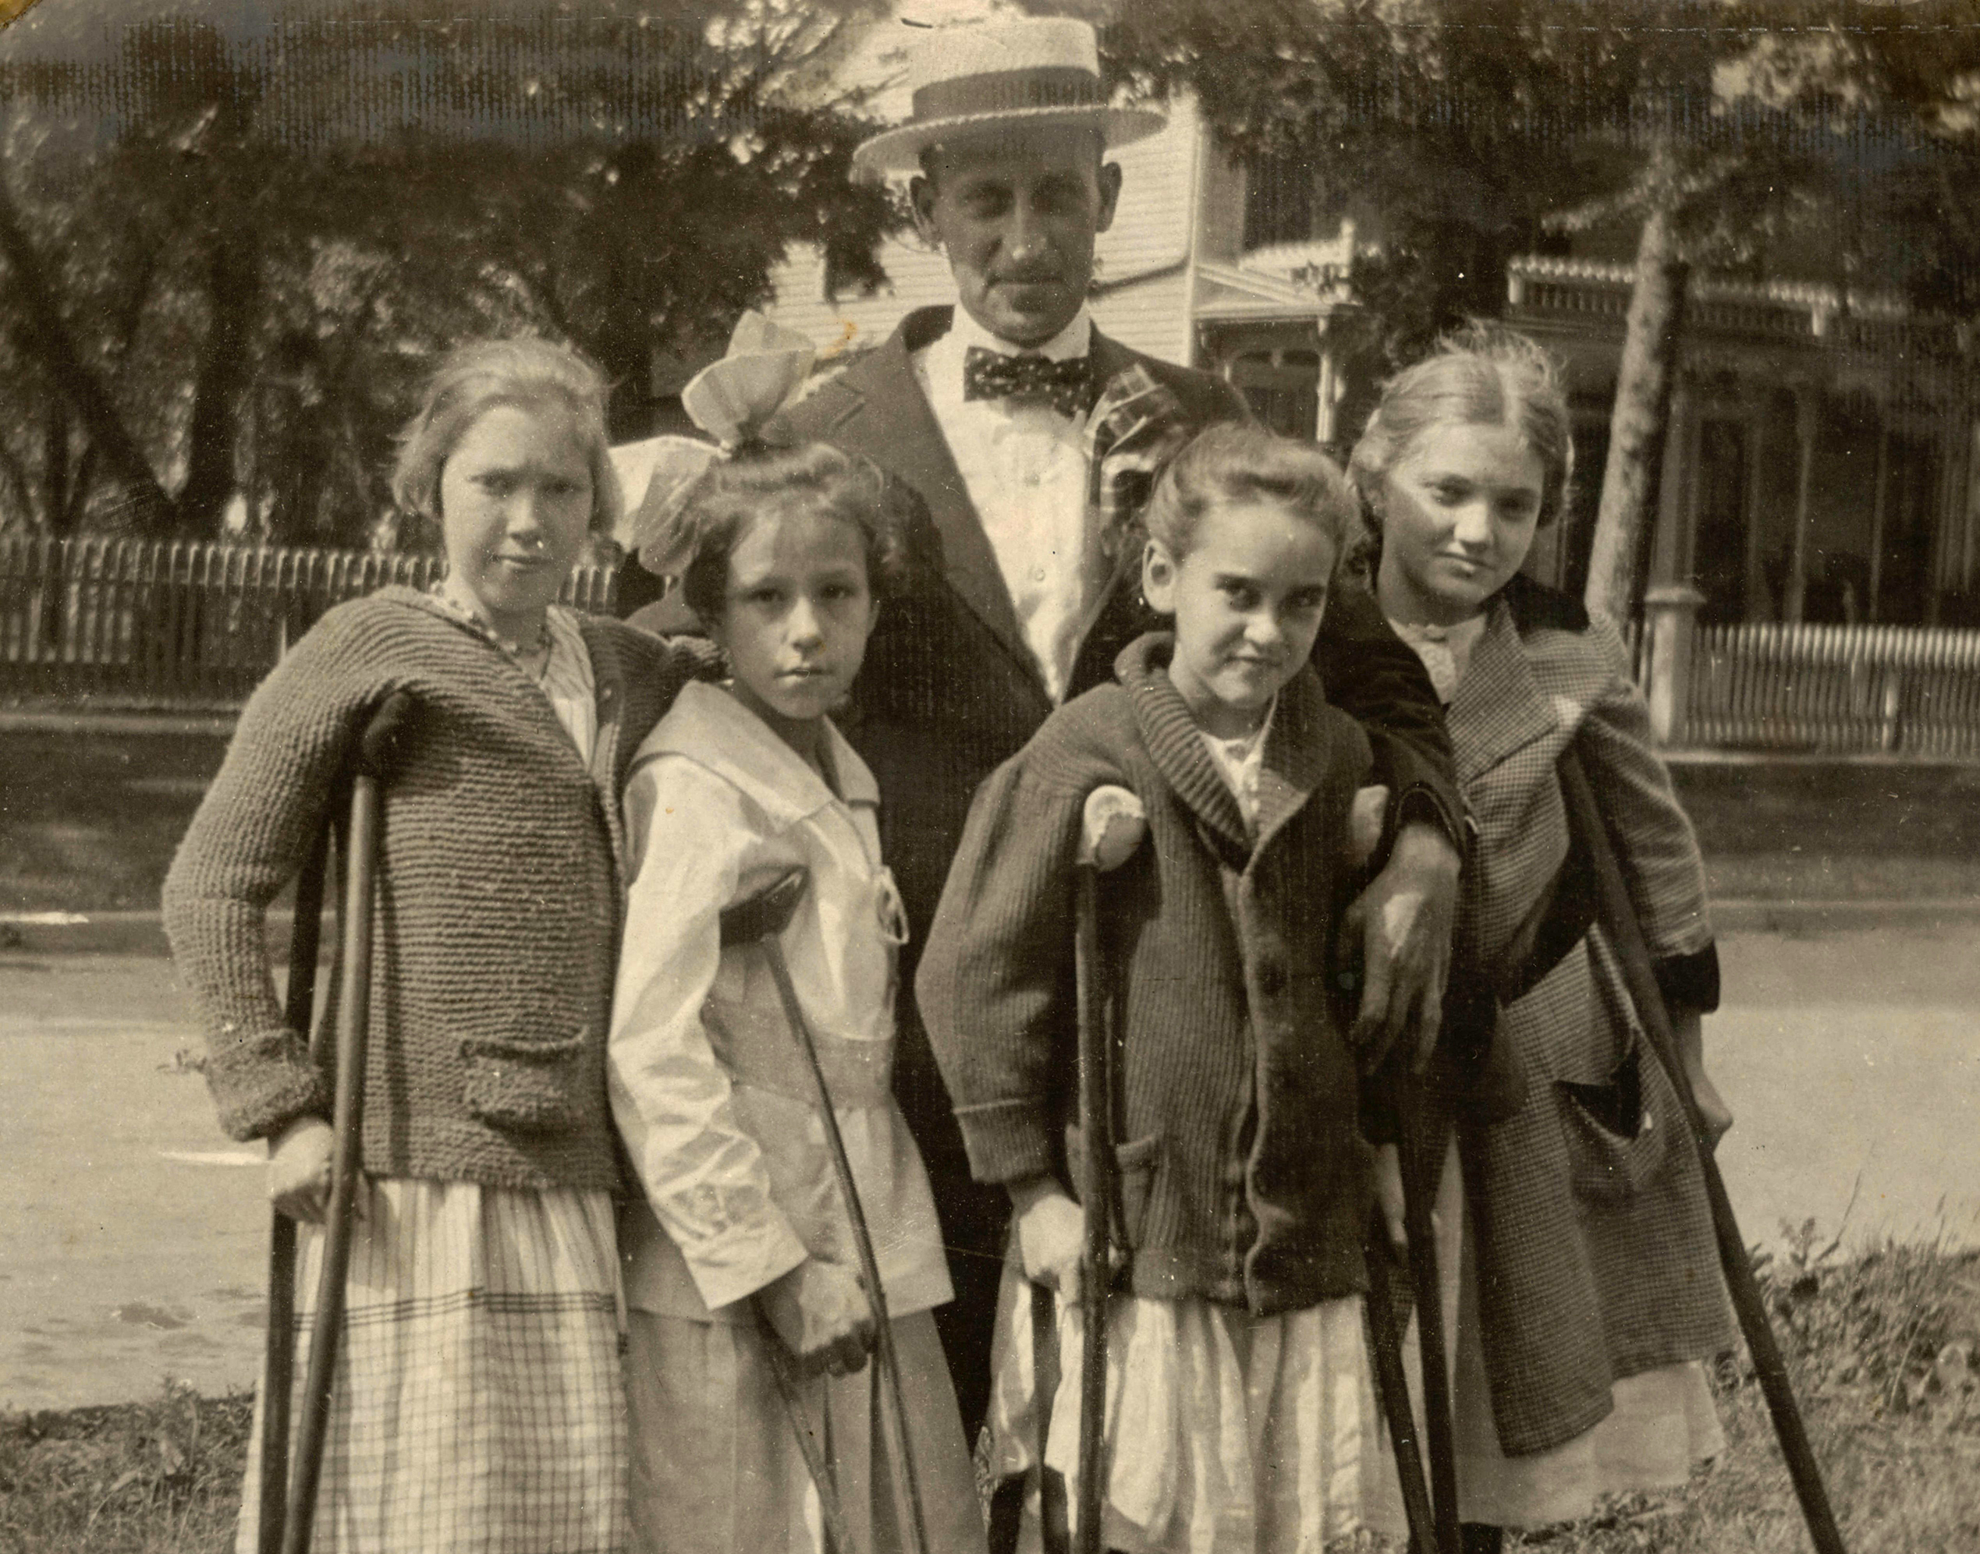

Slide 15
Janet Rhodes Supervisor of Digitization Services Toledo Lucas County Public Library janet.rhodes@toledolibrary.org

