Slide 1
Centering Community Partners to Prioritize Change
Emily Sanderell, Museum History Educator & Collections Coordinator
Brianna Davis Johnson Ph.D., Director of Diversity, Equity, and Inclusion/Chief Diversity Officer
Notes:
9:00

Slide 2
Session Overview
Introductions
Why is History Necessary?
Practical Steps
Our Examples
Breakout!
Q&A

Slide 3
Why is History Necessary?
History teaches vital skills needed in a healthy functioning democracy such as:
Critical thinking
Empathy
Listening
Point-of-view
Bias
Cause & effect
Change over time
Reasoning
Notes:
ES
9:02

Slide 4
The Big Statistic
On average the federal government spends $50 per student on STEM education and 5 cents per student on civics education
Notes:
Statistic resource: https://www.npr.org/2022/03/29/1089467750/in-case-you-missed-it-civic-education-101

Slide 5
How does this statistic make you feel?
ⓘ
Click Present with Slido or install our Chrome extension to activate this poll while presenting.
Notes:
📣 This is Slido interaction slide, please don't delete it. ✅ Click on 'Present with Slido' and the poll will launch automatically when you get to this slide.
9:05-9:10

Slide 6
What can Museums do?
Seize Opportunities & Center Partnerships
Notes:
9:10

Slide 7
Commit to creating welcoming spaces at all levels
Notes:
BJ - talk about what an welcoming space (maybe include what that means specifically for museums) is and why it is important for everyone to commit.
9:10

Slide 8
What can get in the way of creating welcoming spaces for everyone within your organization?
ⓘ
Click Present with Slido or install our Chrome extension to activate this poll while presenting.
Notes:
📣 This is Slido interaction slide, please don't delete it. ✅ Click on 'Present with Slido' and the poll will launch automatically when you get to this slide.
9:10-9:15

Slide 9
Seek opportunities for programs that lead to partnerships
Notes:
ES
9:15-9:20
Share story about being open/on the look-out for opportunities to partner like through our Smithsonian connection

Slide 10
Places to Look
Other local community non-profits
Other museums
Local, State, and National organizations
County or City Historical Alliances
OMA, OLHA
AAM, AASLH, Smithsonian, Library of Congress, PBS
Local small businesses
Other educational institutions
Notes:
9:15-9:20

Slide 11
Invite in Community Partners (preferably before committing to programming)
Notes:
Both
9:20-9:30
Both
BJ - talk about best practices for starting the partnership (talk about my own experience getting started with the Works)

Slide 12
Best Practices For Community Partnership
Museum Perspective
Be Flexible
Be Open-minded
Partner with organizations with similar goals
Shared commitment to improving the community through DEI
Bring in community experts & solicit their feedback
Community Partner Perspective
Seek partners with shared values
Communicate about what, how, and when you can contribute
Understand your role in the partnership
Stay in communication
Notes:
https://docs.google.com/document/d/1gh5HfTTbHIgW5QihroXpGogkYjKMuZyy/edit
https://www.aam-us.org/2023/04/21/the-messy-and-vulnerable-truth-about-trust-and-museums/
B.J. - add to “community partner perspective” section
9:20-9:30

Slide 13
Take Risks & Forgive Yourself
Notes:
ES
9:20-9:30

Slide 14
5. Do Post-Evaluations
Notes:
ES
9:20-9:30
Give examples: Color of Care in too big a space. Importance of maintaining communication with partners.

Slide 15
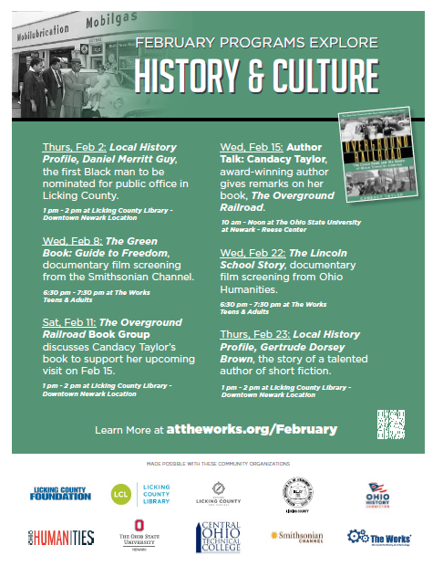
What We’ve Done
The Color of Care
2. The Overground Railroad
Notes:
9:30-9:40 (5 mins for each event)
BJ - talk about Color of Care event planning & experience
ES - talk about The Overground Railroad event planning & experience
ADD FLYERS

Slide 16
Notes:
BJ - show video
9:30-9:40 (5 mins for each event)

Slide 17
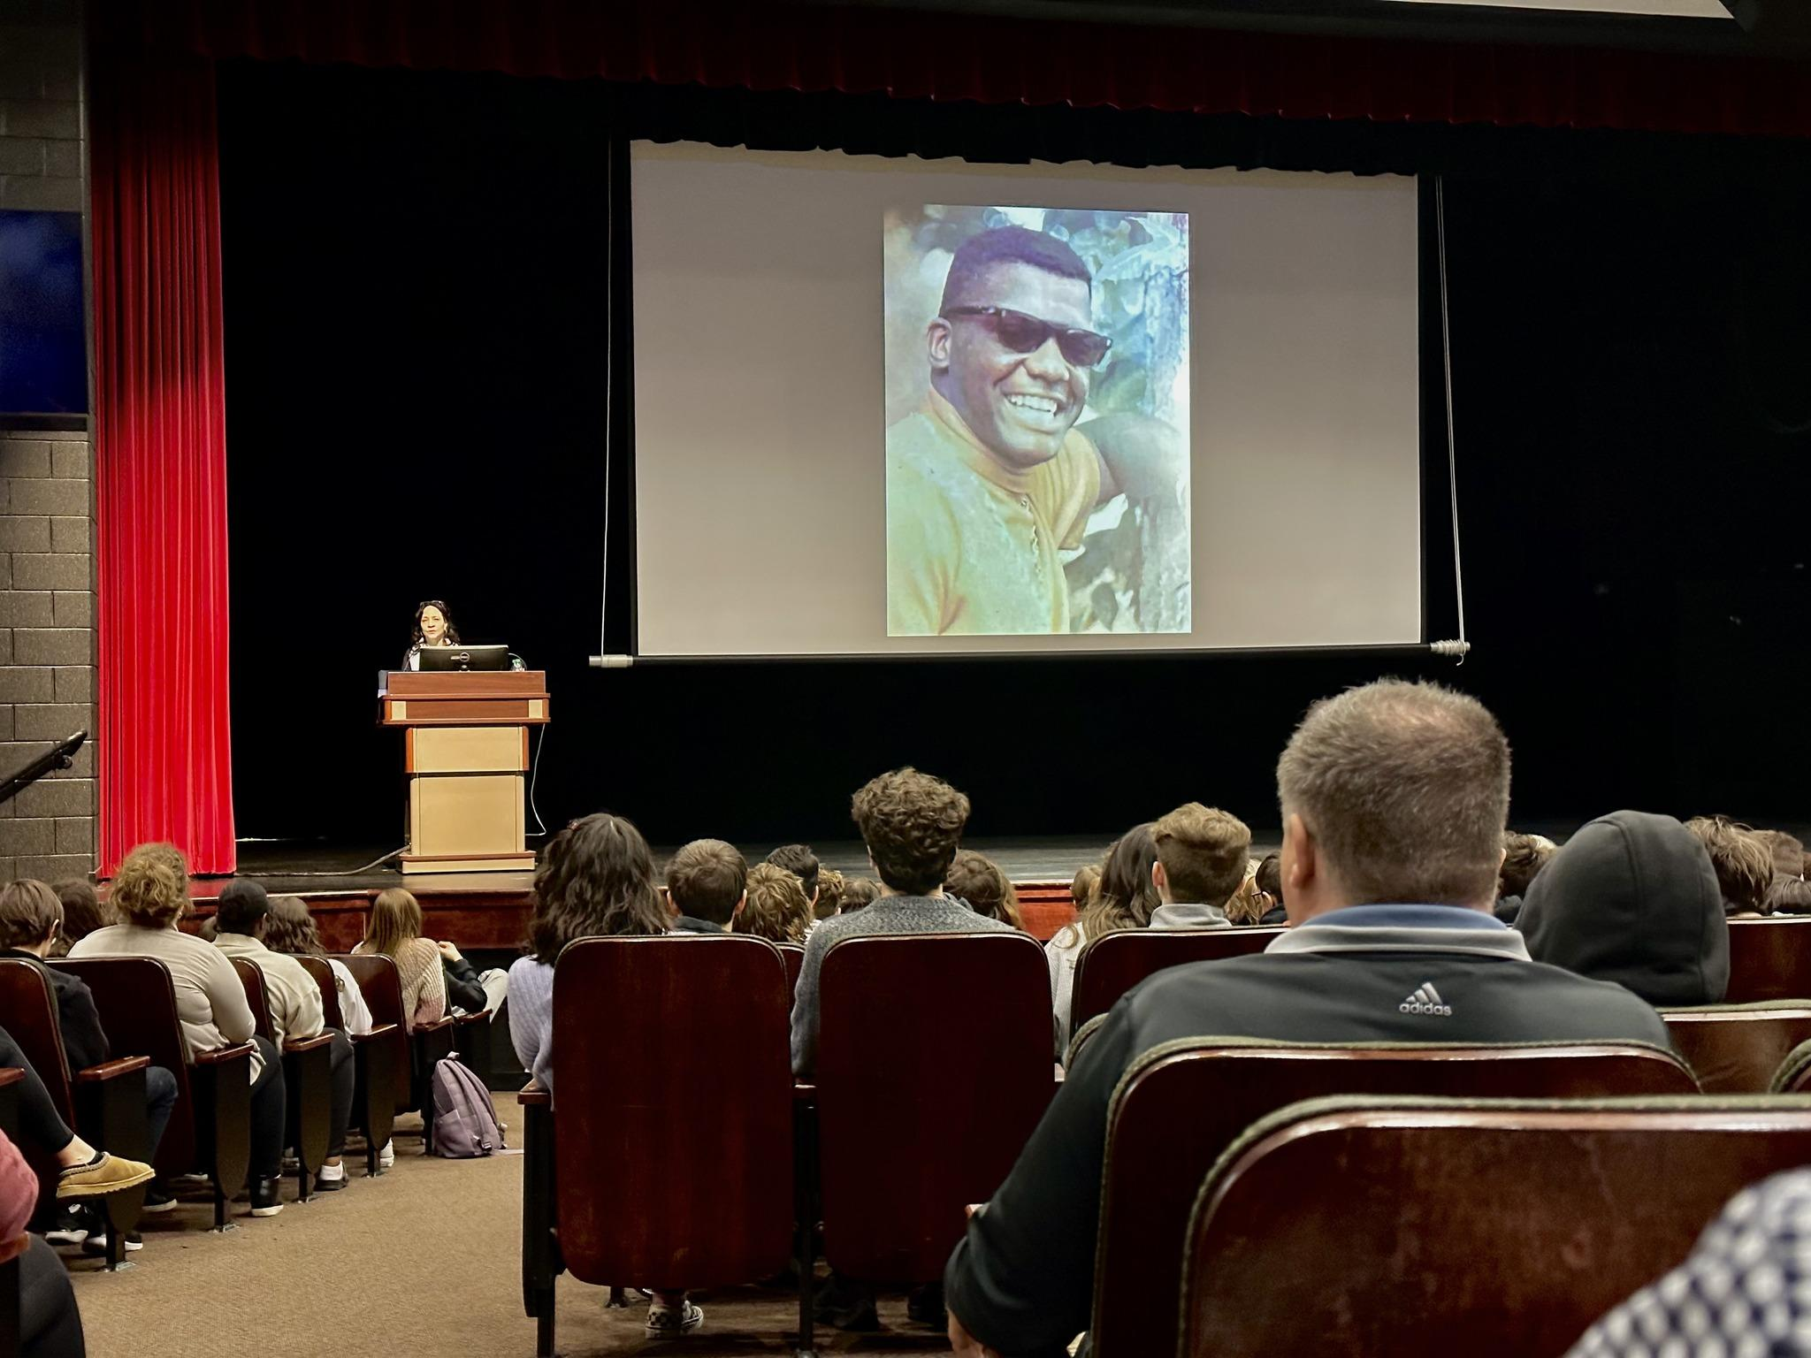
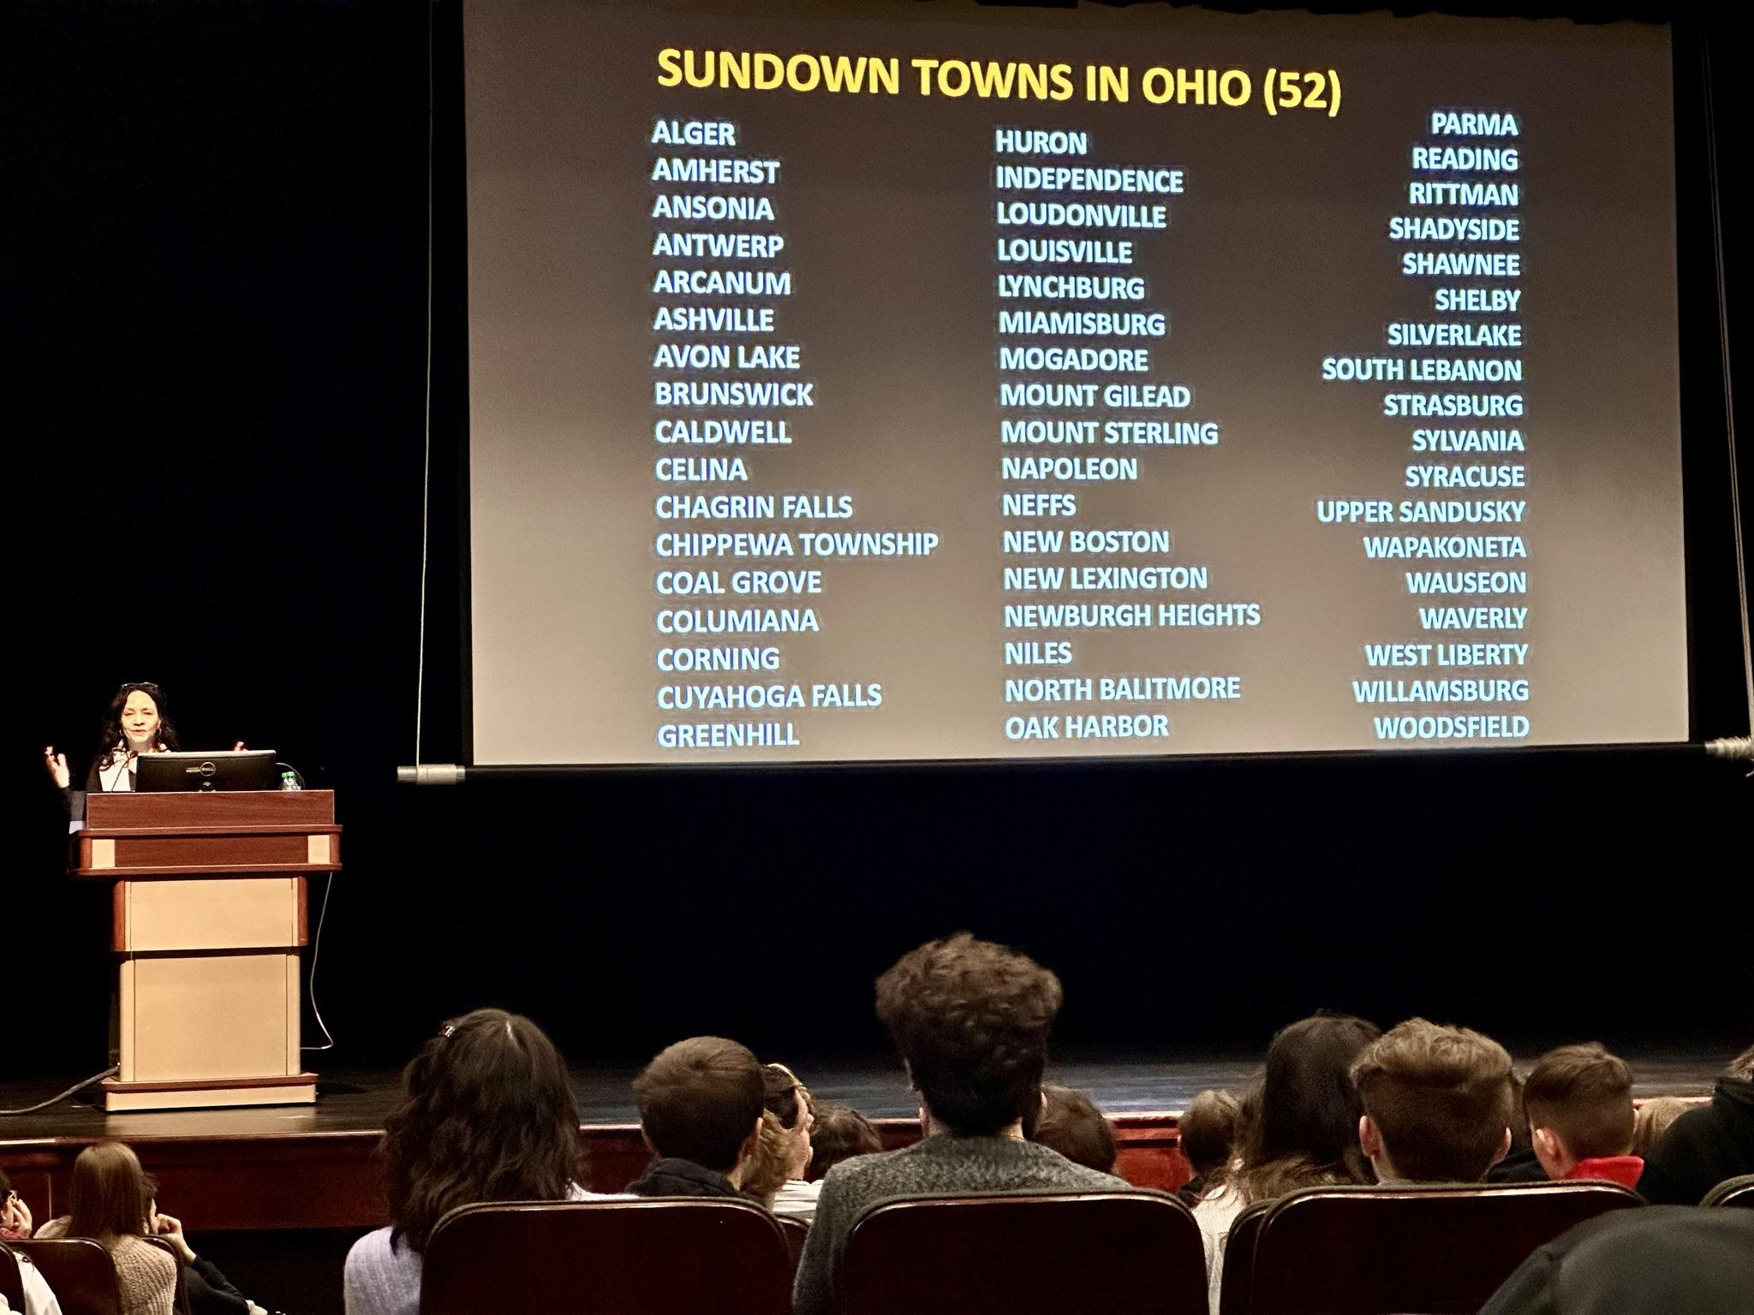
Notes:
ES
9:30-9:40 (5 mins for each event)

Slide 18
“I received the incredible collection of postcards from the students and I am overwhelmed with gratitude. They are so thoughtful and so special. The drawing of me and my mother brought tears to my eyes. Thank you for adding this joy to my life.”
~ Candacy Taylor, Author & Speaker
Notes:
9:30-9:40 (5 mins for each event)

Slide 19
What has your experience been in building community partnerships?
ⓘ
Click Present with Slido or install our Chrome extension to activate this poll while presenting.
Notes:
📣 This is Slido interaction slide, please don't delete it. ✅ Click on 'Present with Slido' and the poll will launch automatically when you get to this slide.
9:40-9:45

Slide 20
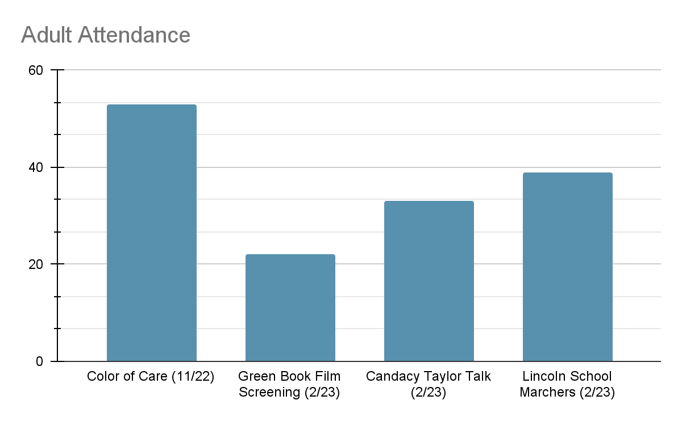
Outcomes
More conversations in the community about DEI
Notes:
9:45-9:47
Expanding points:
1) Expanded our reach to adults and secondary/high education students. (300+ students attended Candacy’s talk)

Slide 21
Outcomes
2. Overground Railroad integrated into Newark City Schools 10th grade curriculum
3. Community relationships to continue nurturing
Notes:
9:45-9:47
2) Has helped school teach students about The Great Migration & Harlem Renaissance. Taylor has also continued to connect with NCS.
3) We can work with partners in many way, we can work with other museums/non-profits, we can rebuild relationships.
Licking Memorial Hospital
Licking County NAACP
Licking County Foundation
Licking County Libraries
Ohio State Newark & Central Ohio Technical College
Ohio Humanities
Ohio History Connection

Slide 22
BREAKOUT!
What’s one partner you’d like to reach out to after this session? Why?
What conversations do you want to commit to having?
Notes:
9:47-9:50

Slide 23
Audience Q&A Session
ⓘ
Click Present with Slido or install our Chrome extension to show live Q&A while presenting.
Notes:
📣 This is Slido interaction slide, please don't delete it. ✅ Click on 'Present with Slido' and the questions from your audience will appear when you get to this slide.

Slide 24
Contact Information
Emily Sanderell
Museum History Eductor & Collections Coordinator
emilysanderell@attheworks.org
Brianna Johnson, PhD
Director of Diversity, Equity and Inclusion/Chief Diversity Officer
johnson.9155@osu.edu

