Slide 1
DCHS
October 2023
DELAWARE COUNTY HISTORICAL SOCIETY
Volunteer & Recruitment Insights
Karen Cowan and Susan Logan, Volunteers
October 6, 2023
01

Slide 2
Content
01
Who We Are
02
Our Why
03
Our Structure
04
Recruitment Process
05
Job Matching
06
Retention Efforts
07
Future Goals
02

Slide 3
OUR WHY
Why we do what we do
04

Slide 4
Why Do We Exist
VISION
MISSION
A community that values its history as it plans its future
We strive to be a trusted resource to preserve and connect the diverse stories and fabric of the past to the people of today and tomorrow through preservation, education and engagement
03

Slide 5
We delight in discovery
Curiosity about the past illuminates our present and helps us prepare to navigate tomorrow.
We get things done
We are committed to our communities and tackle the work of interpreting our unfolding history with energy.
We welcome you
We seek to provide hospitable spaces for all to gather, engage, learn, and build community. We embrace a diversity of perspectives in our storytelling and within our organization.
Core Values
We collaborate
We are enthusiastically committed to the cultural and geographic communities that were and are in Delaware County and embrace the work of interpreting historic people, events and objects as well as preserving our unfolding history
We are stewards
We promote preservation of places, artifacts, stories and memories.
05

Slide 6
WHO ARE WE
The who, when, where
06

Slide 7
Our Team
15
70+
board members
active volunteers
David Hejmanowski
Donna Meyer
Board President
Executive Director
Work in committees
Founded in 1946
Incorporated in 1947
07

Slide 8
Our Committees

Slide 9
Where We Spend Time
Where We Spend Time
Historic Jail & Sheriff’s Residence
Nash House
Cryder Research Library
Meeker Homestead
Museum
Barn at Stratford
Millworker Cottage
08
Notes:
Jail built in 1878 Acquired 2021; Nash House built 1878 Acquired in 1954; Cryder Library purpose built 1971
Meeker House built 1823 Acquired 2010; Barn built 1848; Acquired 2010; Millworker Cottage built 1852; acquired 2018

Slide 10
ACCOMPLISHMENTS
Examples of how we stay busy
09

Slide 11
History of Achievements
Designed and delivered 10-11 Adult evening programs annually
Average attendance: 70-80
Completed 1 Oral History project and working 2 more
Added 24 years of daily newspaper and 11 Delaware City Directories to Ohio Memory
Registered 26,000+ items
Placed 55 videos on YouTube
Interact with 3,500 primary grade students annually
5 museum building
Offsite exhibits in public libraries, government buildings, store windows
Applied for and received 4 grants last year
Received 5 awards for programming from OLHA
10

Slide 12
RECRUITMENT PROCESS
How we find our talent
11

Slide 13
Recruiting Prep
Bring a positive attitude
“We want you”
“If you want to volunteer, we will search for positions where you can contribute and flourish”
Know what you need
Job descriptions for positions
What do you want them to do?
What skills do they need?
How much time will it take?
Be open, sharing, flexible, and listen!
12

Slide 14
Finding People
Advertise
Social Media – Facebook, Website
In organizational publications
DCHS Insider – a publication for DCHS Volunteers
On community sites- Volunteer Connection – Delaware County
At DCHS activities
Monthly programs
When our museums/facilities are open
Community Outreach
Have booths and distribute Volunteer Brochures at community events.
Be members of and participate in other community organizations
Walk-Ins & The Personal Touch
13

Slide 15
Utilizing Relationships
Promote “bring a friend” or “bring a spouse” to events and programs
Follow up when we hear of potential interest
Talk about your Historical Society whenever you get a chance
The project manager who needs volunteers should help with recruiting
14

Slide 16
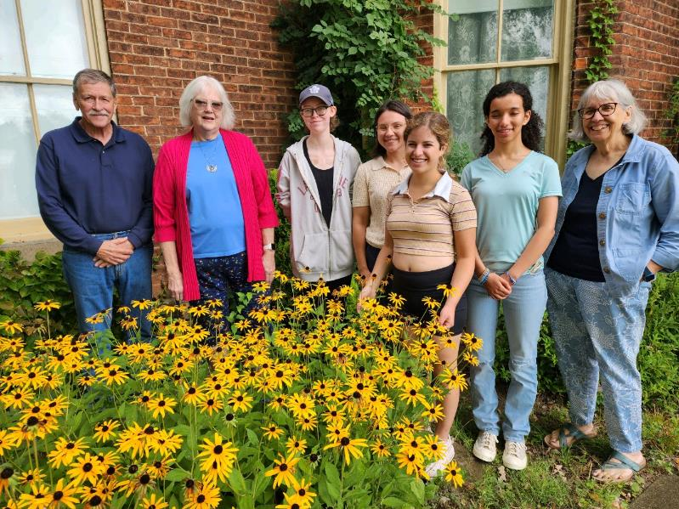
Understand Who Volunteers and Why
Acknowledge why people want to volunteer
College interns or college students fulfilling community service hours
High school student fulfilling community service hours or want experience
Those who want job preparation skills
People looking for a "community"
Court required community service hours
People who like history
People who are having life experiences
Welcome all types of people always
Embrace volunteers’ differences
High school students present challenges, but they bring phenomenal computer skills
People with disabilities who want job experience
Always say yes to walk-ins
15
Notes:
2 autistic young men have volunteered with us – 1 wanted job experience

Slide 17
Keys to recruiting success
Good volunteers come in all shapes and sizes
Make your organization known throughout the community
Think of reasons to say “yes” we want you
Be flexible - High school and college student have issues with limited hours, but their computer skills are phenomenal – work with their limited hours and get good results
Accept people beyond the community - Just because they aren’t born in your community does not mean that they will be a poor volunteer
Listen to them from the time they walk in the door
Break the “Historical Society” stereotype
16

Slide 18
Thoughts About Recruiting
Considerations
Recruiting is not done in a vacuum
Need to consider what the reputation of the organization is in the community
Open and inviting or closed organization?
Willing to try new things or continue to do things the way they have always been done?
Recruiting is only one step in the 3 R’s of the volunteer process
Recruit
Reward
Retain
Spread attention amongst the 3 R’s (If all attention is put on recruiting, you will forever be frustrated)
17

Slide 19
RETENTION
How we find keep our talent
18

Slide 20
Actions Once We Find Them
New Volunteer To-Dos:
All volunteers complete a volunteer application
Our To-Dos:
Interview Volunteer
Listen to volunteer
Match our opportunities with their interests
Identify project or a committee chair
19

Slide 21
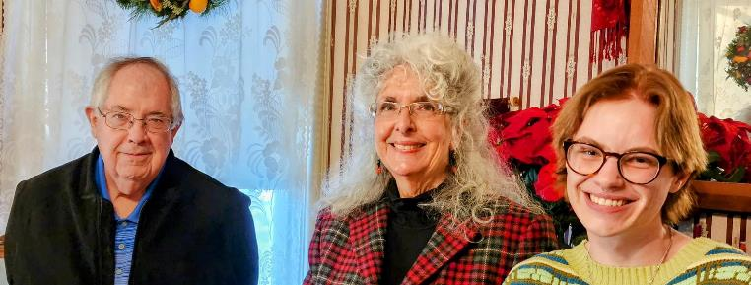
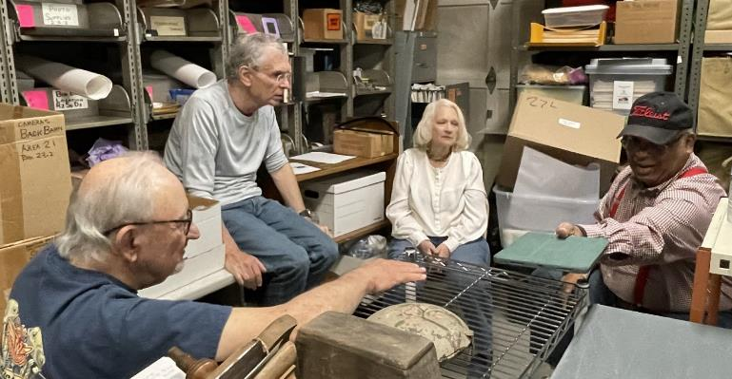
How to Retain Talent
Match talents and skills with tasks
Volunteers need to know they are contributing
Be flexible - allow volunteers do new tasks or old tasks in new ways
Have good job instructions and training material.
Continually take the pulse of your volunteers
Give up ownership of projects; let volunteers own them
Keep an “open” atmosphere; be open to ideas, opinions, and willing to change
20

Slide 22
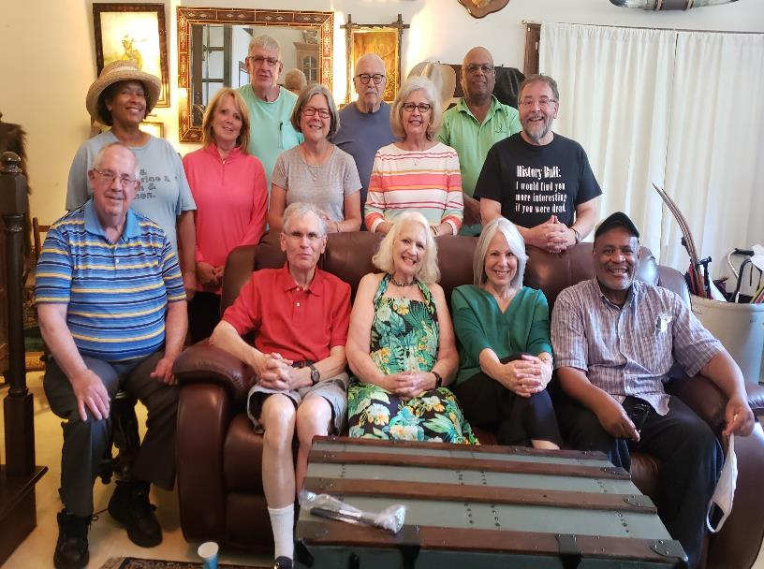
How to Retain Talent #2
Have a wide variety of projects available
Encourage new volunteers to ask questions, share observations, and ideas
Support volunteer participation at relevant meetings, workshops and webinars
Share information – new projects, programs being developed, new donations to process
Share information via newsletters & informal sharing while volunteering
Listen, Listen, Listen!
20

Slide 23
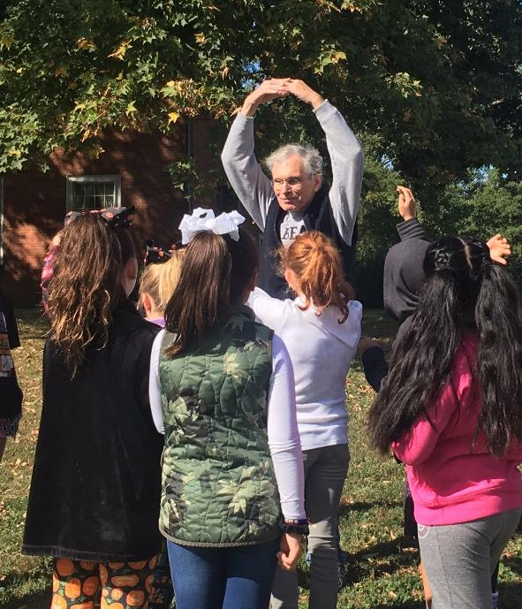
Reward Volunteers
Praise and celebrate with words
“Thank you”
“We appreciate you”
“We could not do this with out you”
Write detailed thankyou letters
Talk to volunteers about what motivates them, listen
Get them together
Volunteer appreciation event
Lunch and learns
21

Slide 24
Continually Look to Improve
It is important to always look for areas of growth. No organization is perfect and that’s okay
Our Challenges We’re Working Through
Keeping track of volunteers
Getting committee chairs connected with the volunteers
Do they enjoy what they’re doing?
Keeping a handle on the pulse of our volunteers
Understanding their “tipping” point - when they get tired or bored
Figuring out what to do once “tipping” point is reached
Each volunteer plays a vital role due to the broadness of our organization
Communicating organizational goals and direction with all volunteers
Recruiting for general positions - docents, staffing booths at First Fridays
Evaluating volunteers’ work
Helping committee chairs involve volunteers effectively
No system dedicated to volunteers
22

Slide 25
Questions?
Contact us@
kcowan@DelawareOhioHistory.org
slogan@DelawareOhioHistory.org
23

Slide 26
Thank You!
23

Slide 27
Job description example
25

Slide 28
How to Retain Talent
Match talents and skills and tasks – if they like what they are doing, they will stay!
Make good use of volunteers
Are there enough tasks for all of the volunteers recruited?
Are people sitting/standing around not doing things?
Do your volunteers feel like they are contributing?
Be flexible enough to let people do new tasks that haven’t been done before
Make good job instructions and training material.
Too detailed that no one can possibly do everything on them?
Too broad that no one knows what to do?
Keep an “open” atmosphere – be open to ideas, opinions, and willing to change
Keep the work environment professional yet casual
Solicit and use volunteer input
Continually take the pulse of your volunteers
How are they feeling about the work they are doing?
Do they feel appreciated?
Do they want to learn or do something more or something else completely.
Don’t overuse your volunteers - most volunteers DO NOT want a full time job volunteering
20

Slide 29
More Ways to Retain
Give up ownership of projects – let volunteers own them
Always include new volunteers in meaningful tasks
Don’t foster cliques - If you only work with people you are familiar with, no one new gets involved and you won’t get new ideas
Have a wide variety of projects
Keep volunteers informed with more information than they would get as member – i.e. Volunteer Newsletter
Listen, Listen, Listen!
21

